Slide 1

Election Judge Training
General Election
November 3rd
2026
The Illinois State Board of Elections

Slide 2
Timeframes Prior to Election Day
Early Voting:
40th day to 1st day prior to Election day
Sept 24th
Vote by Mail:
40th day to 5th day prior to Election Day, can apply 90 days prior.
Sept 24th
Grace Period Registration & Voting: 27th day through Election Day
Oct 7th
Oct 6th
Close of Registration: Regular: 28th day prior to Election Day; Online: 16th day prior to Election Day: October 18th
Notes:
Grace Period Registration & Voting: Can go directly to the election authority’s office or any other designated site. 27th day prior to the election through Election Day.
Early Voting: 40th day to 1 day prior to Election day.
Vote by Mail: May apply 90 days prior to Election day. 40th day to 5th day prior to Election day.
Close of Registration: Regular close, 28th day prior to Election Day. SBE Online close, 16th day prior to Election Day.
If you are not scheduled to work in your precinct on Election Day, make sure to take advantage of one of these days to vote beforehand.

Slide 3
Voters that Require ID
Voters who’ve registered & have provided inadequate proof of identity, along with newly registered voters.
ID required prior to voting!
Driver’s license or State ID
Utility Bill
Student ID & mail addressed to address of residence
Government Check
Paycheck
Lease or contract for residence
Bank Statement
Other government document
They must show name and address documentation that match the records.
Notes:
Persons who apply to register to vote by mail but provide inadequate proof of identity to the election authority shall be notified by the EA that their registration has not been fully completed.
They remain ineligible to vote by mail or in person until such proof is presented.
These individuals will be flagged in the verification records going out to the polling places on election day.
If a “newly registered voter” provides sufficient identification (see above list) he/she will be allowed to vote.

Slide 4
Before the Polls Open: Chapter 1
During Voting Hours: Chapter 2
After the Polls Close: Chapter 3

Slide 5
Before the Polls Open:
Chapter 1

Slide 6
Arrive at your designated time
If judges do not show up – call!
Can replace missing judges AFTER 6:15 A.M.
Check supplies – is anything missing?
Set up or reconfigure voting area
Call your election authority if you discover any problems!
Notes:
Designated time: usually around 5:00 AM
If judges do not show up, first give them 15 to 20 minutes, then try and get ahold of them. If you are unsuccessful, call your election authority. If your EA cannot find you a replacement judge, you as Election Judges are allowed to swear in another judge, AFTER 6:15 AM, who is of the same political affiliation as the missing judge.
You want to make sure the voting area has enough privacy for the voter.

Slide 7
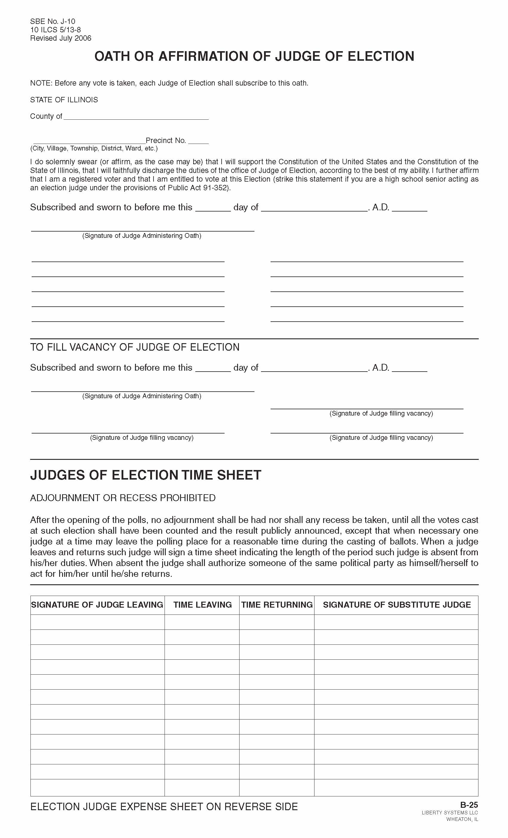
You are Officers of the Circuit Court!
Uphold the U.S. and Illinois Constitution.
You are the sole authority in the polling place.
You are the sole authority in the Campaign Free Zone.
You are responsible for the proper conduct of the Election

Slide 8
Remember to…
Rotate positions – it reduces fraud & its law
Act as a board– majority rules
Have equal authority-No head judge

Slide 9
Stay Organized!
Match your supplies with the checklist in your supply kit.
If anything is missing, call your election authority.

Slide 10
Set up voting area
Arrange voting booths for privacy – give the voter as much privacy as possible.
Allow for orderly flow of voter traffic in the polling place.
Reminder: Tabulator(s) must be in full view of election judges!

Slide 11
Make sure the voter is given the correct ballot sheet!
Ballot sheets are designated by code, color, or number.
The ballot sheet code, color, or number should match watch is on the voter’s application.
Notes:
Check that the date and the precinct designation on the ballot sheets are correct.

Slide 12
Compare each ballot style to each specimen ballot to verify that the following is listed correctly:
Each office
The “vote for” on each office
Each candidate
Then ALL judges sign the
“Certificate of Inspection”
Notes:
When the tabulator is turned on and the zero tape prints, you will need to conduct the same inspection with the zero tape against the specimen ballot.

Slide 13
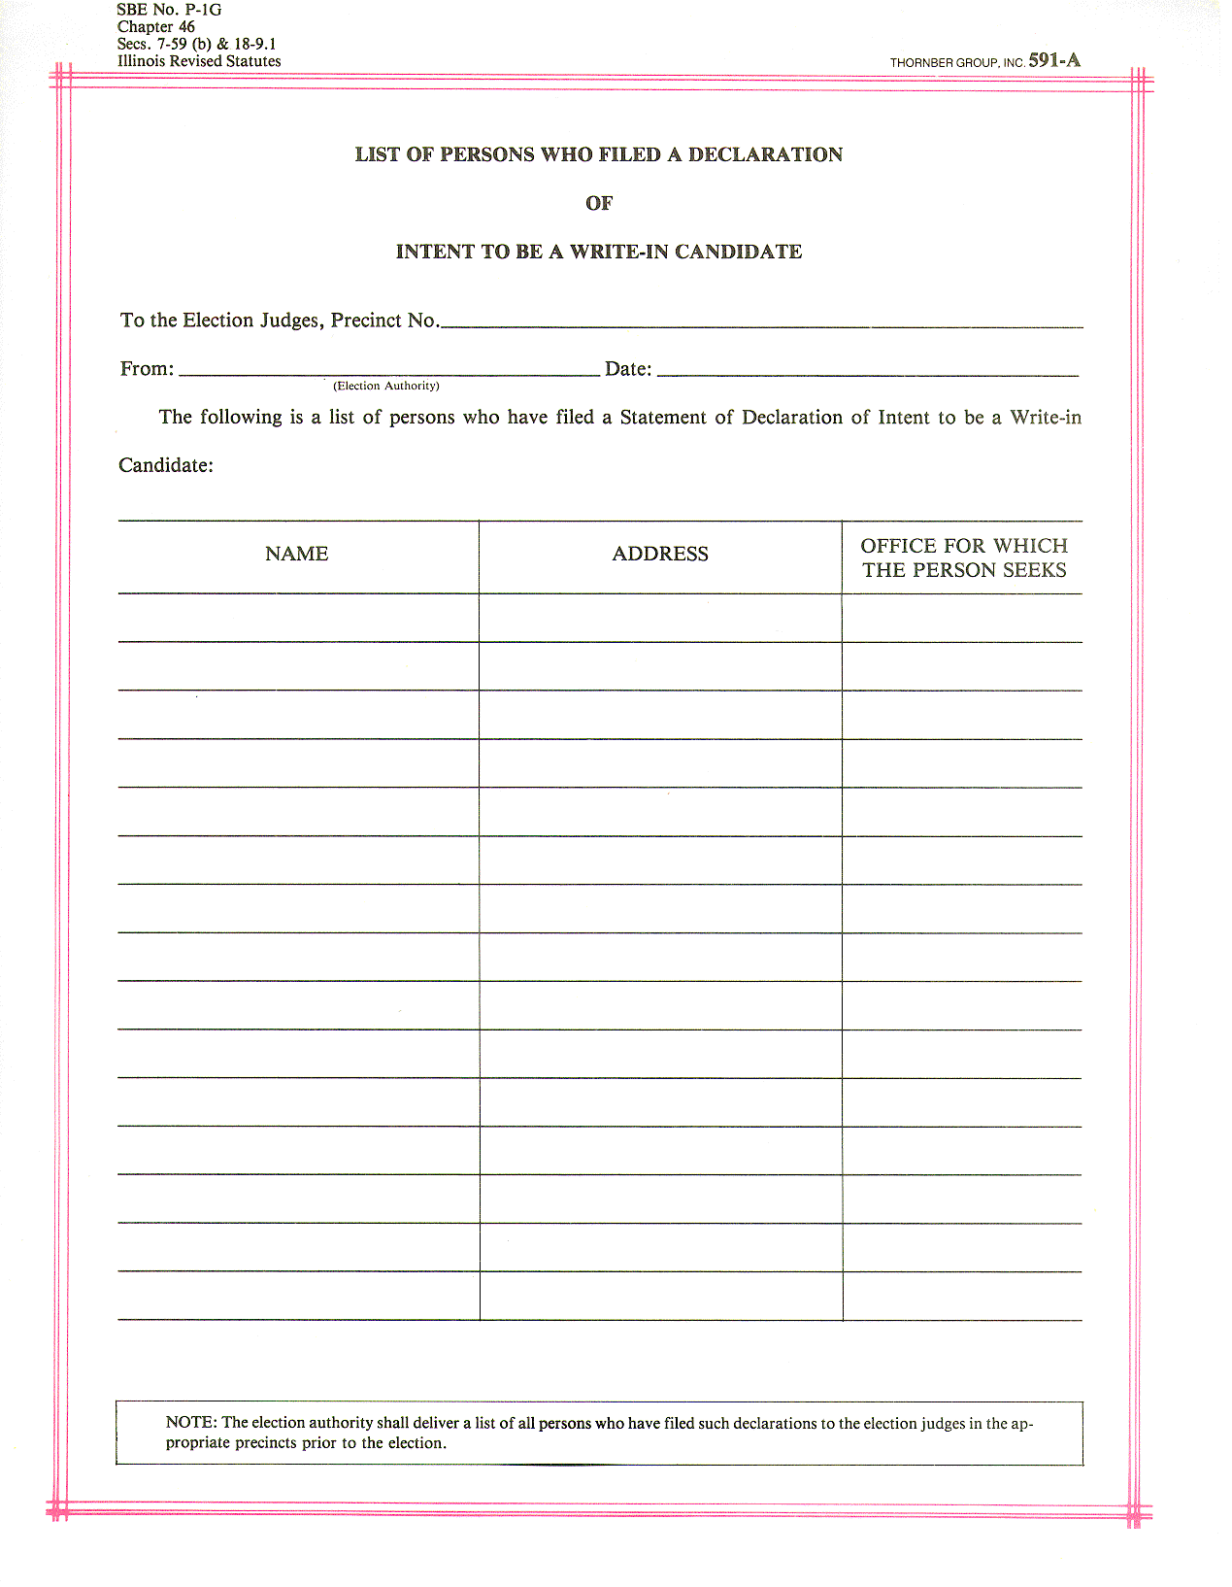
Valid Write In Candidates
(list will be provided in your precinct kits)
There will only be valid write-in candidates on this list (candidates filling 61 days prior to election day*).
This list should NOT be posted anywhere in the polling place.
Write-in list can be shown to the voter if they have requested to see it.
Notes:
Write-in lines will only be printed for those offices that have had a candidate submit a declaration of intent to be a write-in candidate.
If a write-in candidate is running in a district that goes into more than one election jurisdiction, the candidate must file this “Declaration of Intent to be a Write-In Candidate” form in every election jurisdiction in which he/she would like to have their write-in votes counted.
*Exception: When an objection to a candidates nominating papers is sustained (thereby creating a vacancy), then write-in votes shall be counted for persons who have filed a notarized declaration of intent for that office not later than 7 days prior to the election. In those cases, the election authority will have lines printed on the ballots for races that have objections pending at the time of ordering the ballots.

Slide 14
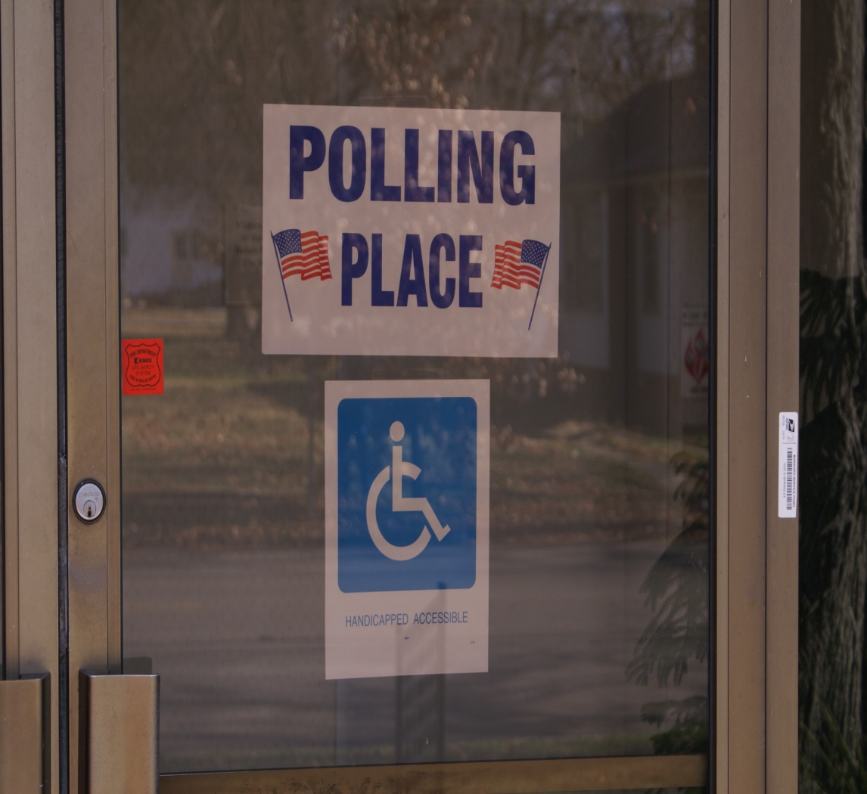
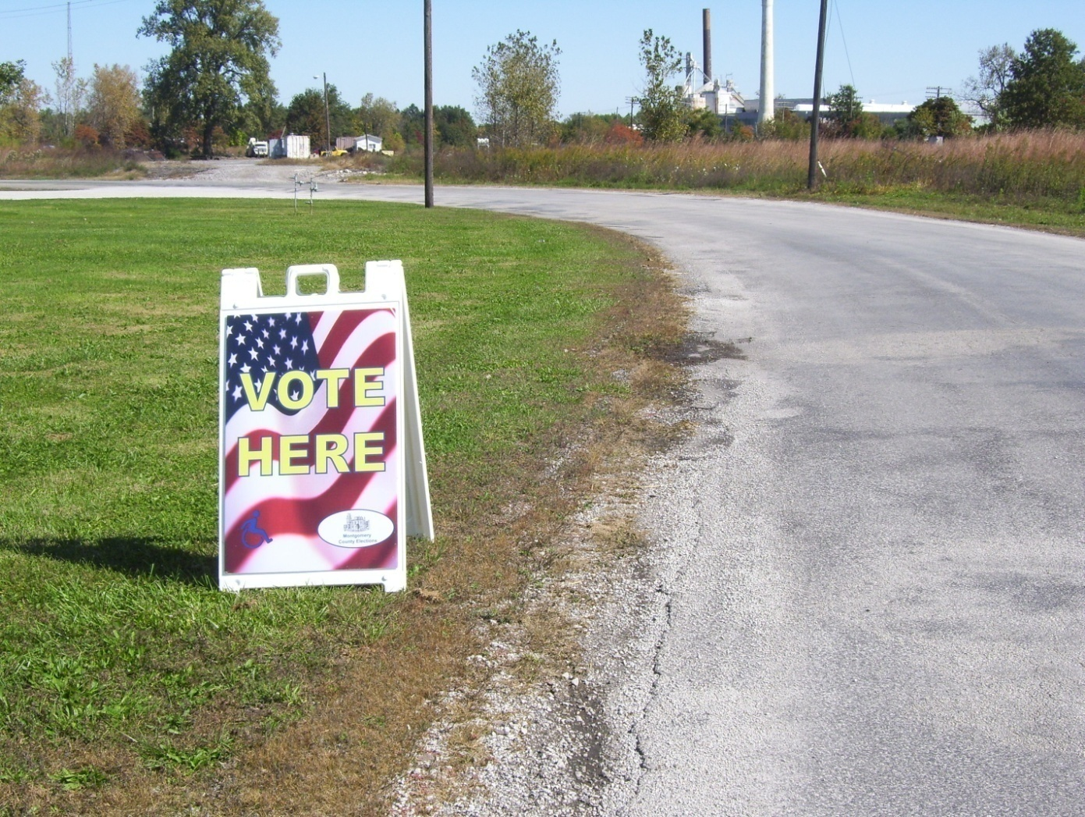
Polling Place Entrance Sign & ADA Compliant Sign
Public Roadway Polling Place Sign
Should clearly identify the entrance
ADA sign may not be on the main entrance used by most voters
Should be placed on the public roadway nearest to the entrance of the polling place
Must clearly identify polling place

Slide 15
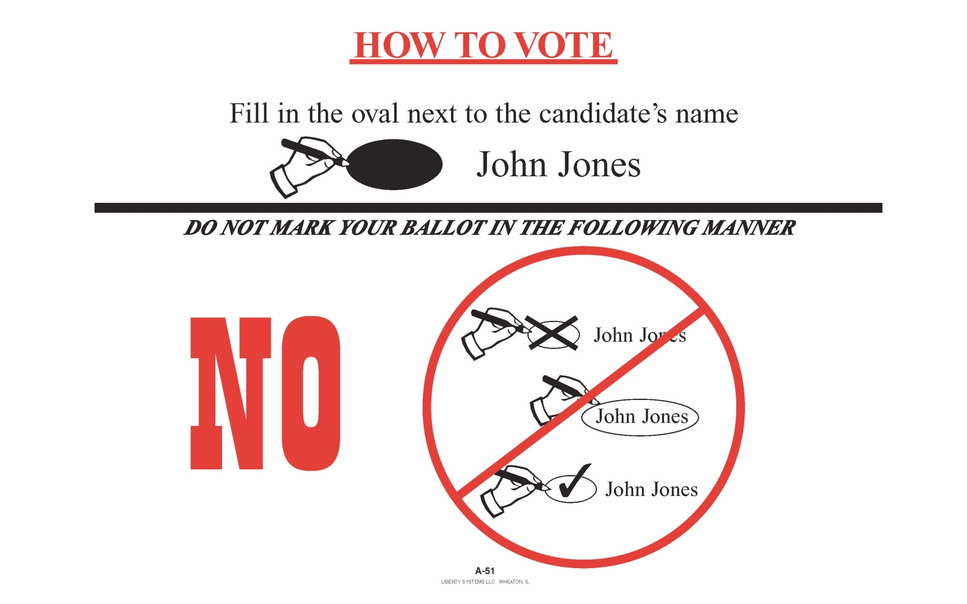
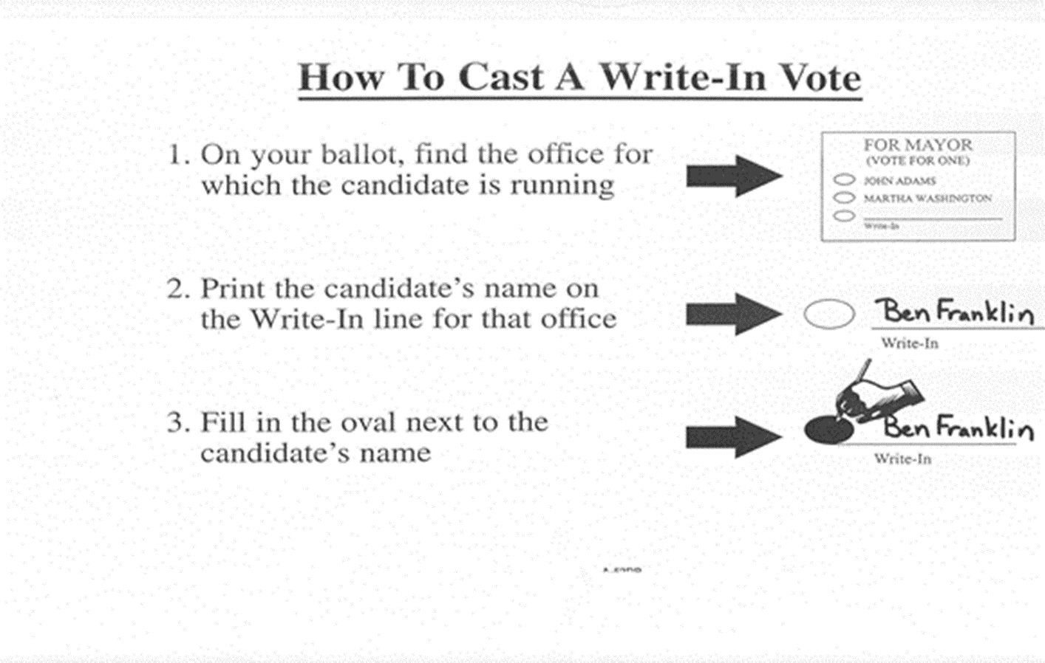
Post Instructions in Voting Booths and around Polling Place!

Slide 16
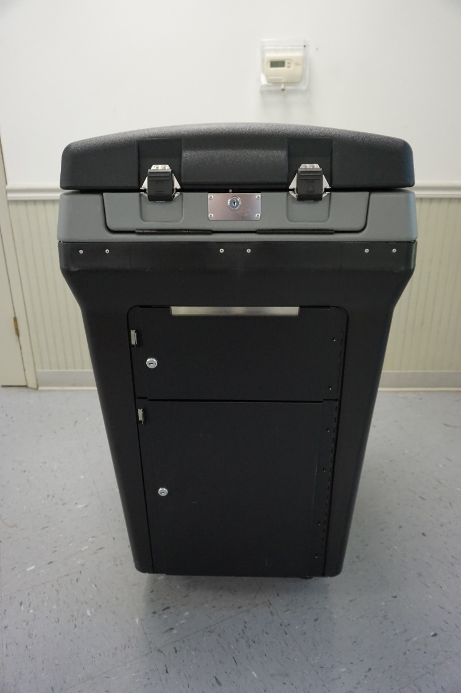
DS200 Tabulator Preparation

Slide 17
DS200 Tabulator Preparation
Instructions will be provided

Slide 18

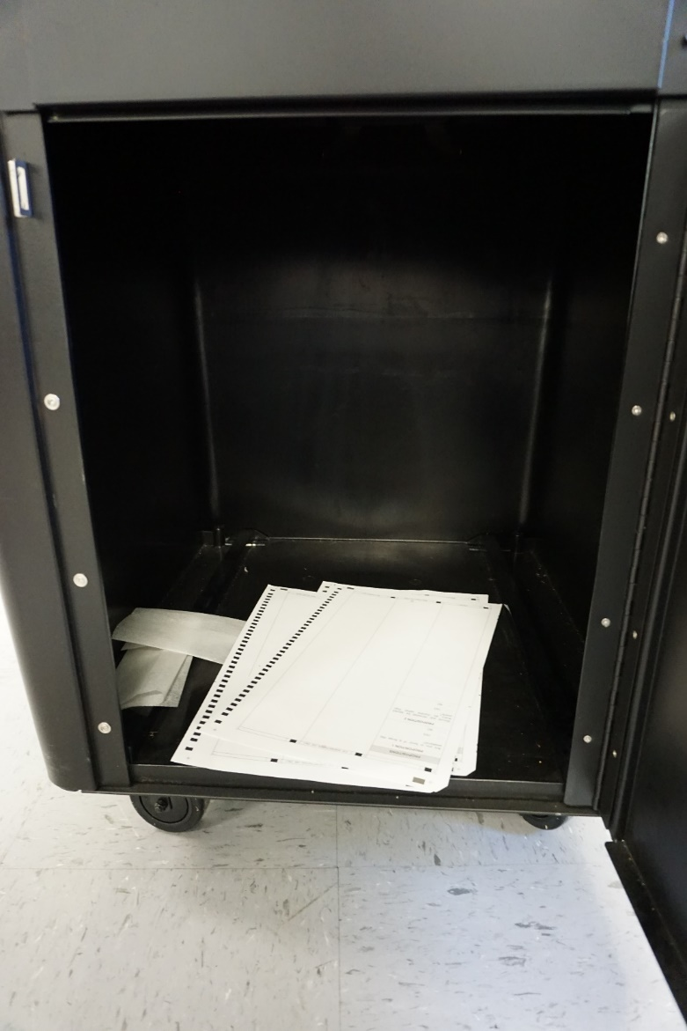
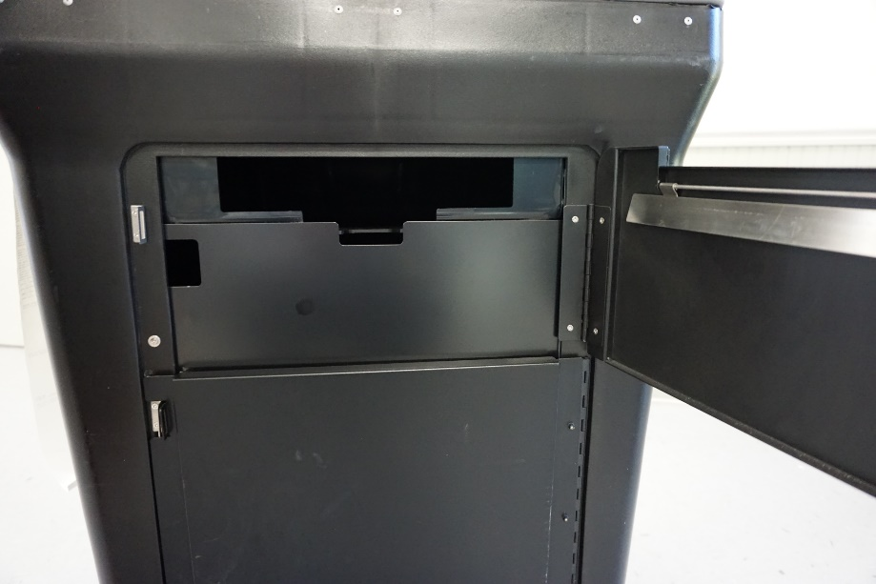
Verify that all compartments of the ballot box are empty.
Notes:
Where the ballots drop in from the tabulator, but also the auxiliary bin compartment, located on the front of the ballot box.

Slide 19
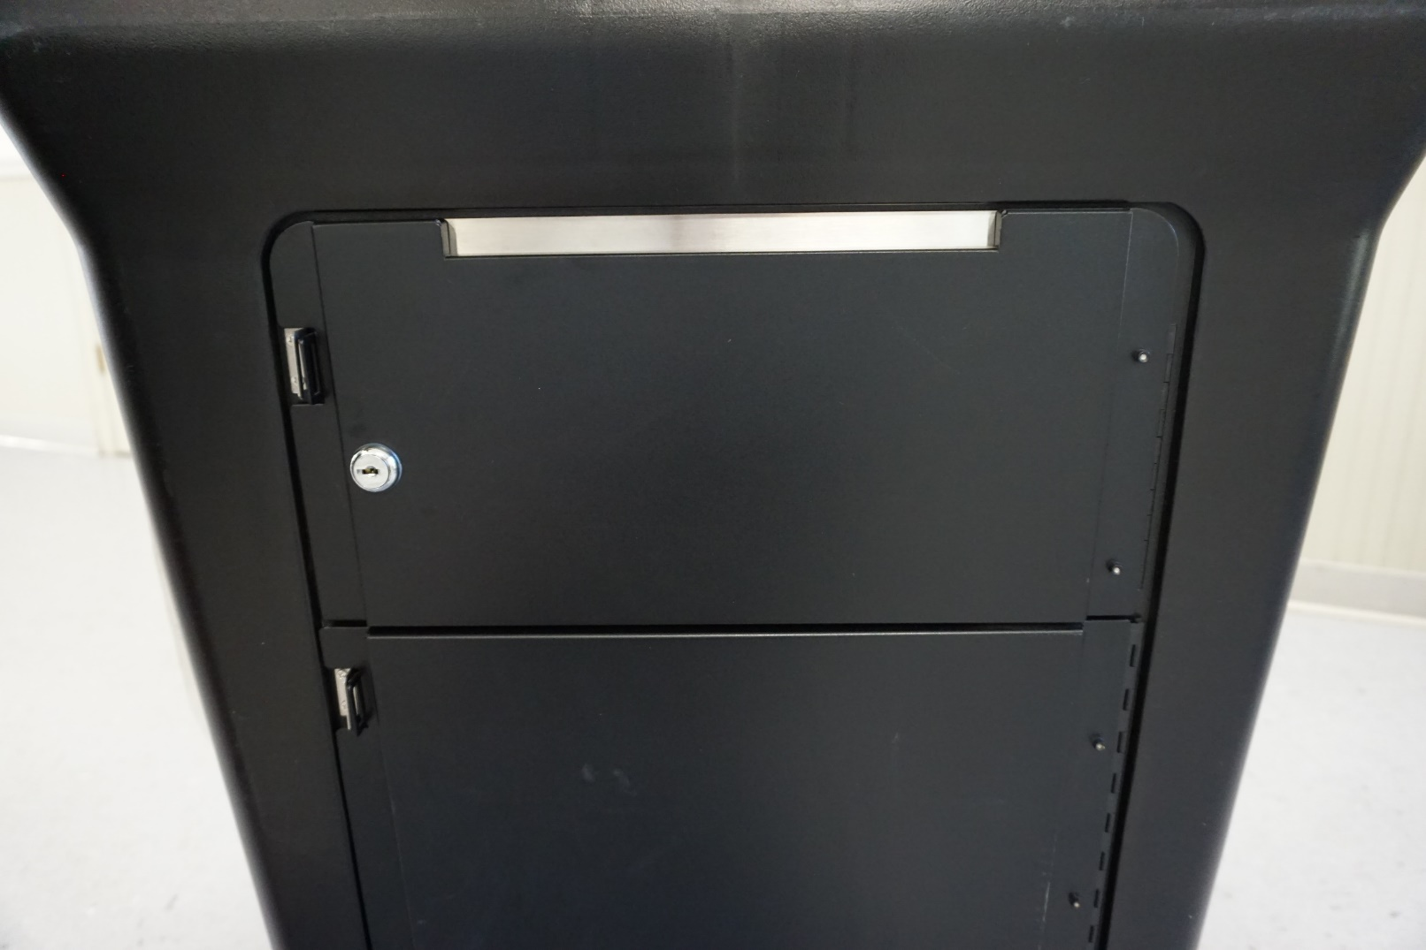
Close and lock all compartments!
All compartments should remain locked until after 7:00 p.m.

Slide 20
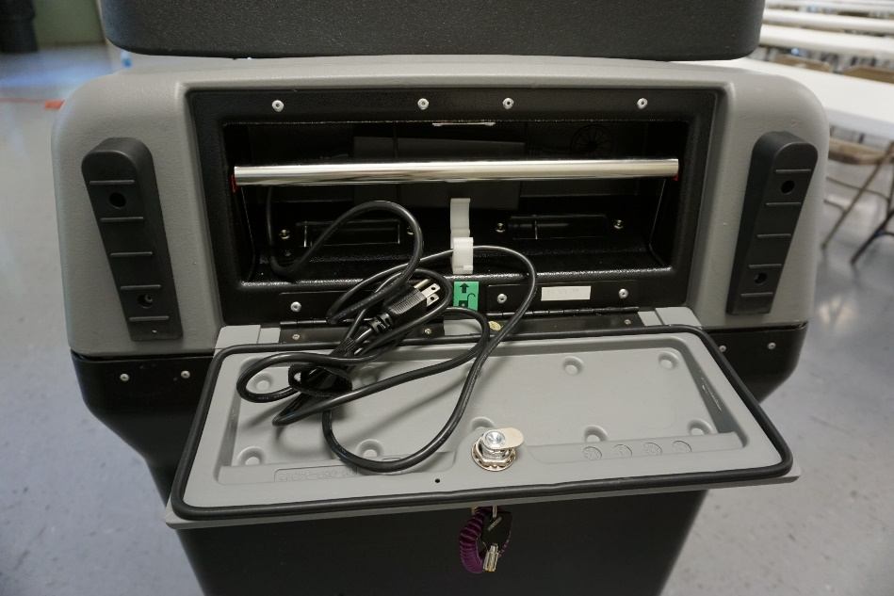
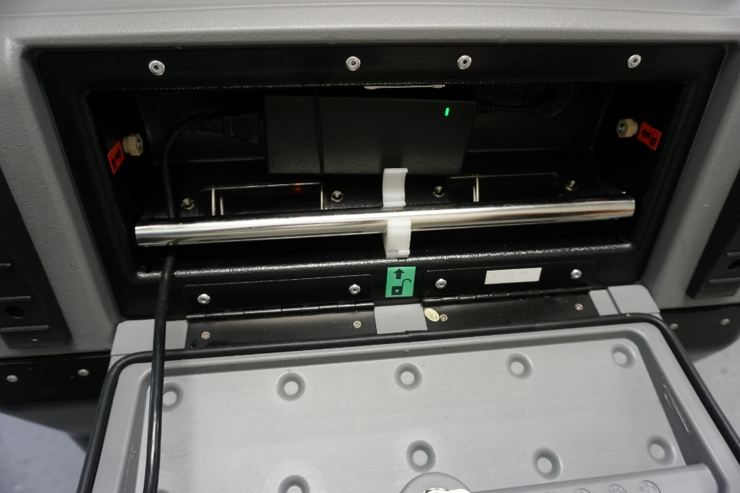
Remember (on the back of the tabulator) to push the bar down to lock it in place so ballots can be dropped into the ballot box.

Slide 21
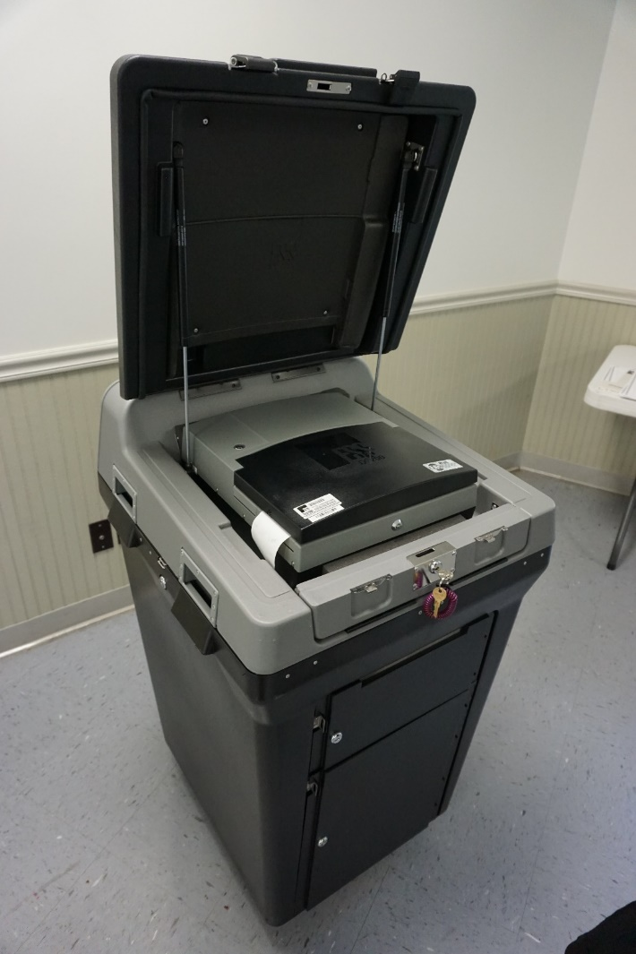
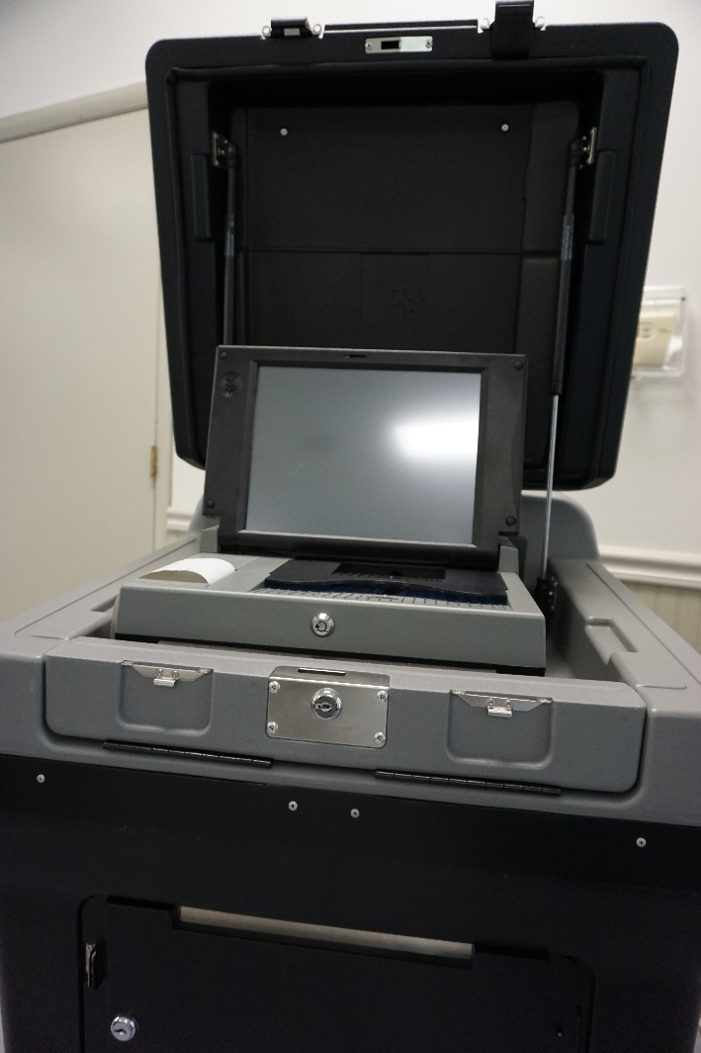
Unlock and Open
Open the large cover over the tabulator.
Flip open the touch screen.

Slide 22
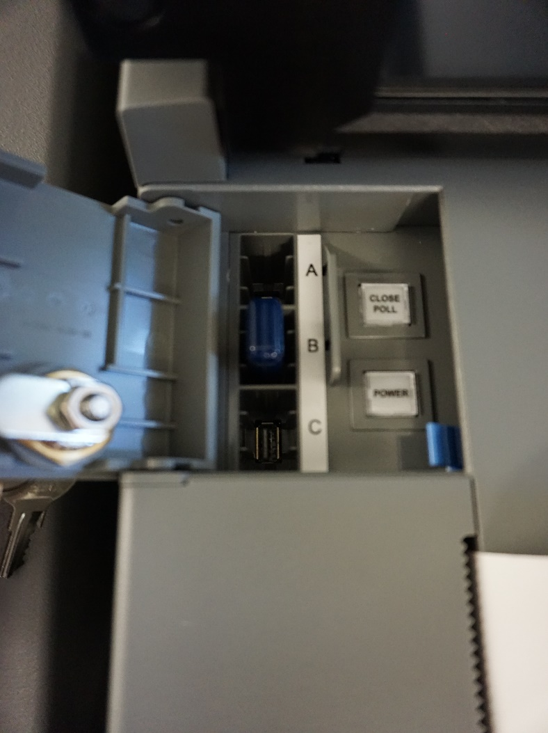
Memory Stick
Verify that the memory stick is inside.

Slide 23
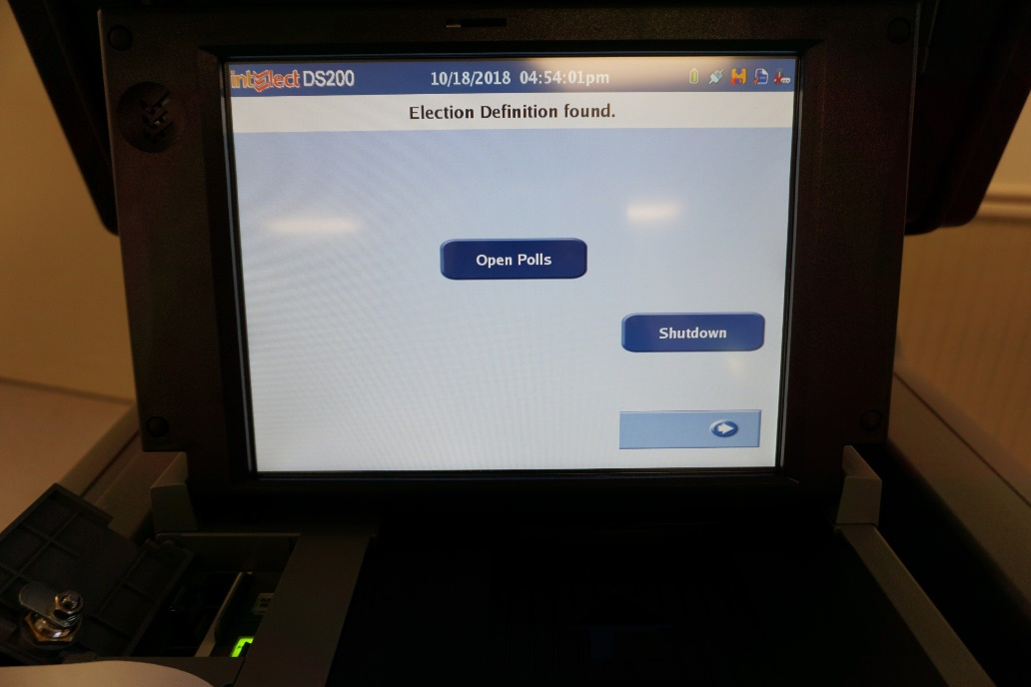
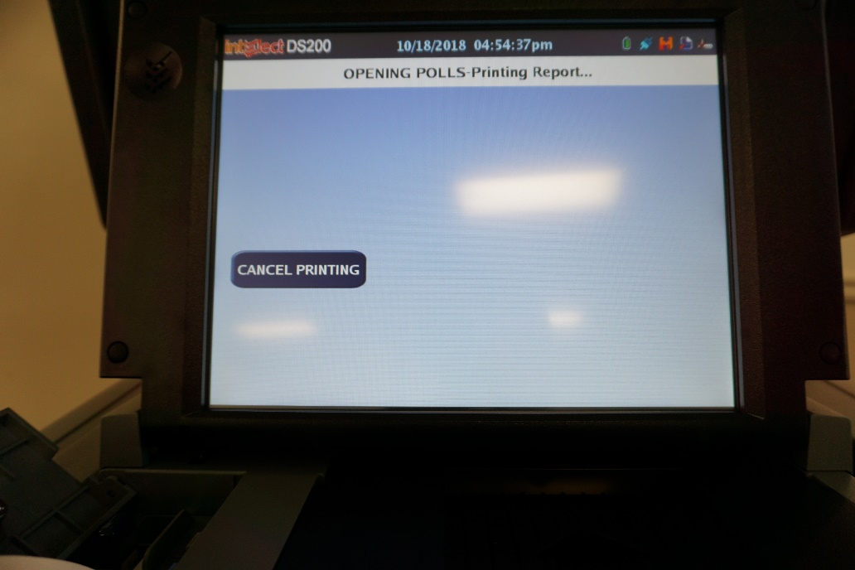
Type in election code
Press “Open Polls”
Print zero report

Slide 24
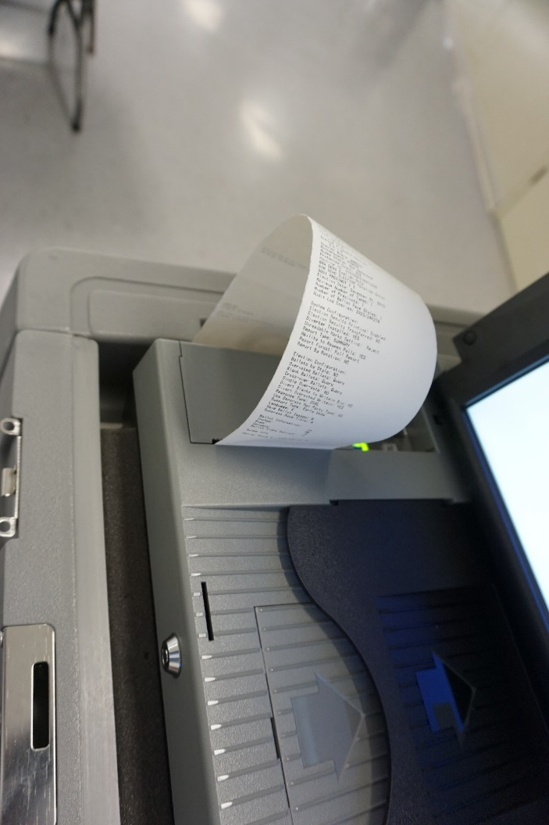
Zero Tape
Check Date and Time on Tape
Verify that the zero tape has no votes cast.
Check for correct precinct name and number.
Compare the tape to the specimen ballot.
Each judge must sign the zero tape.

Slide 25
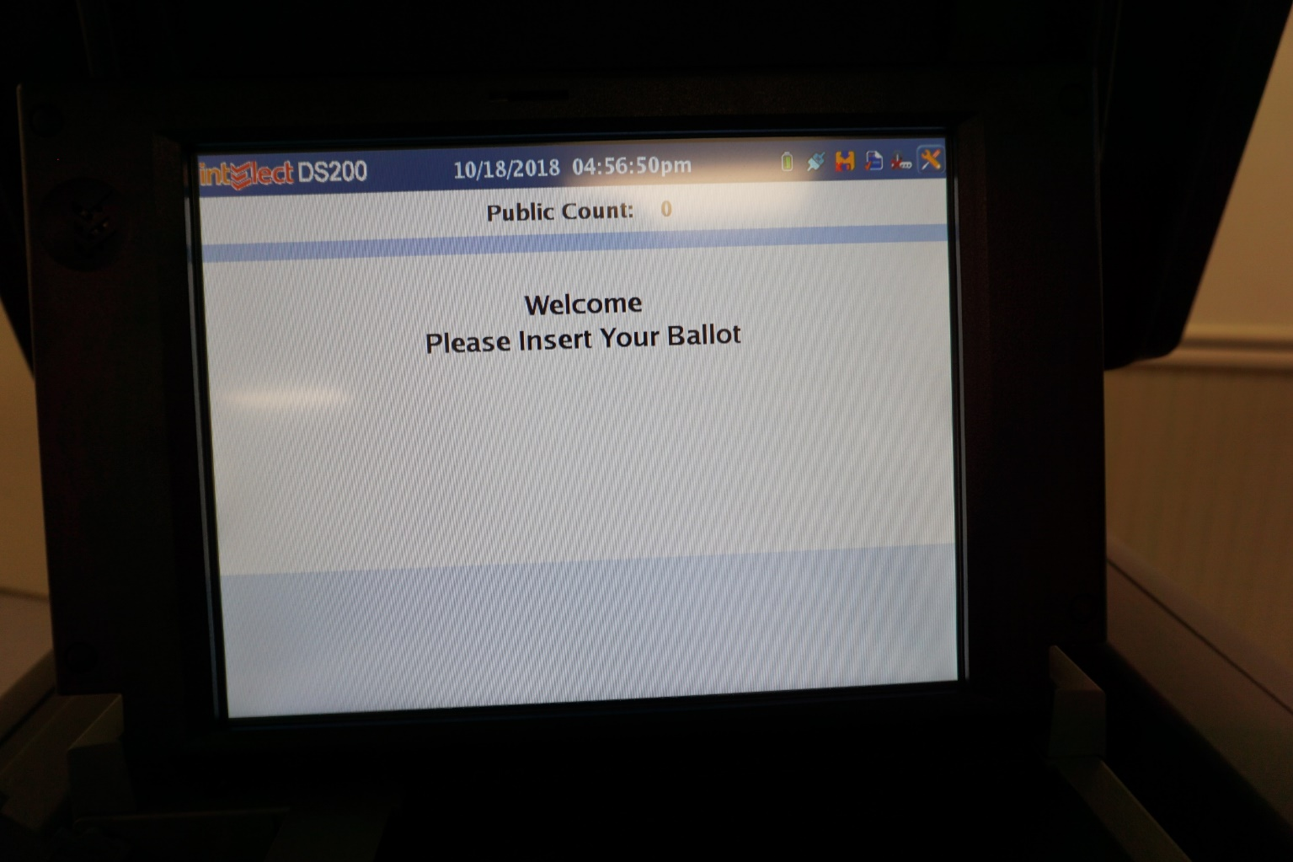
Verify public count is set to ZERO!

Slide 26
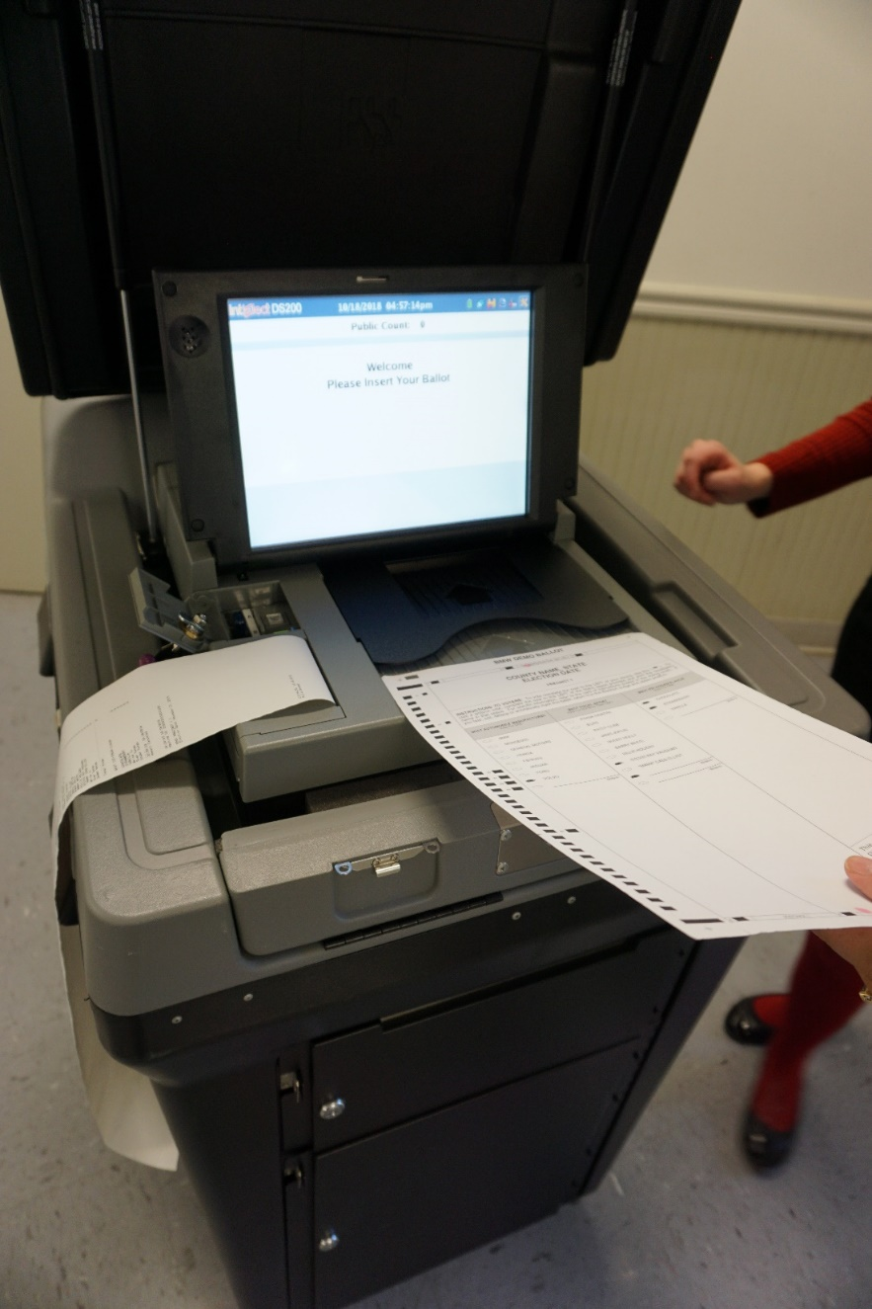
The DS200 Tabulator is Ready!

Slide 27
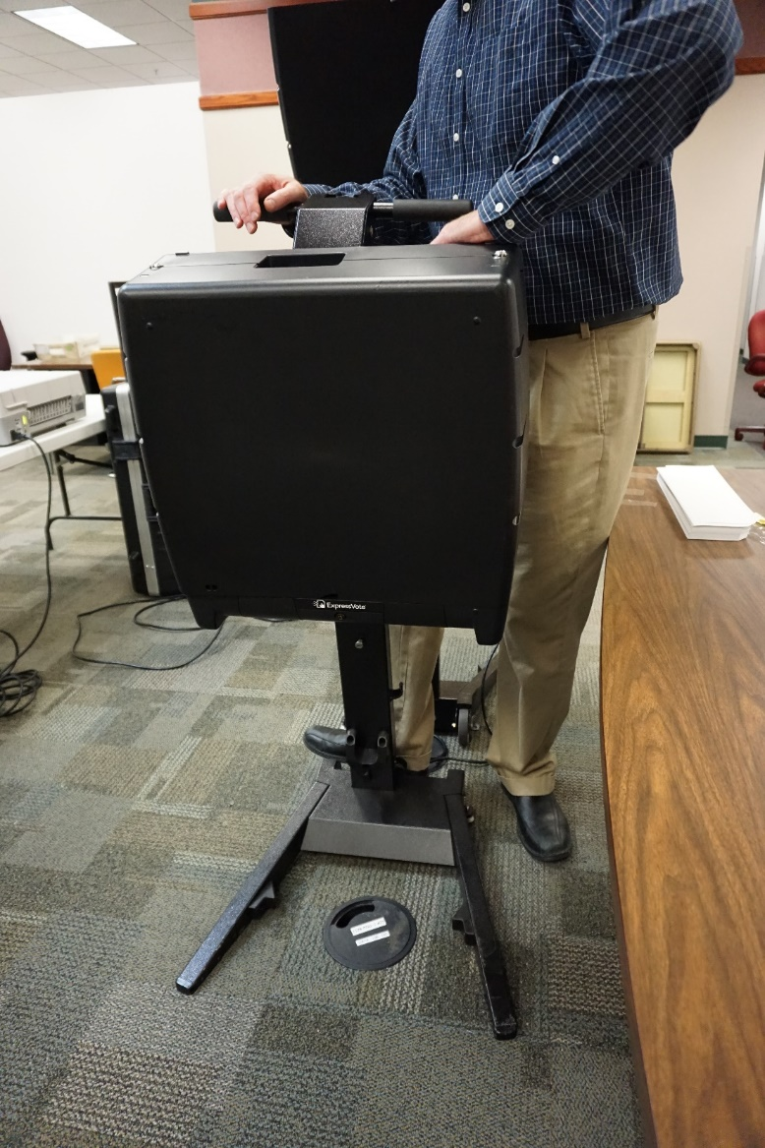
Express Vote Preparation

Slide 28
Express Vote Preparation
Instructions will be provided

Slide 29
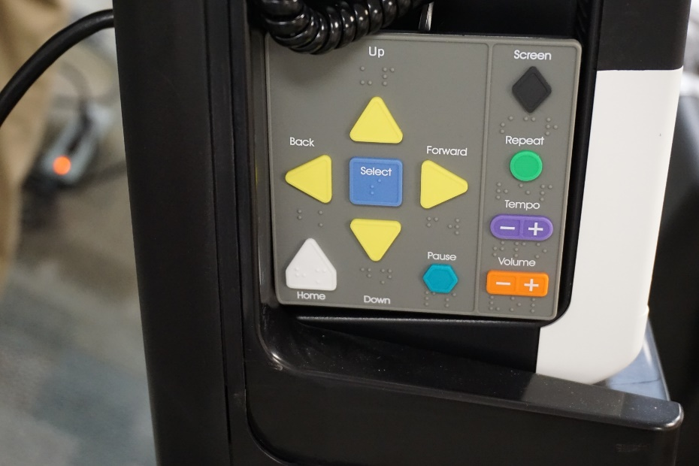
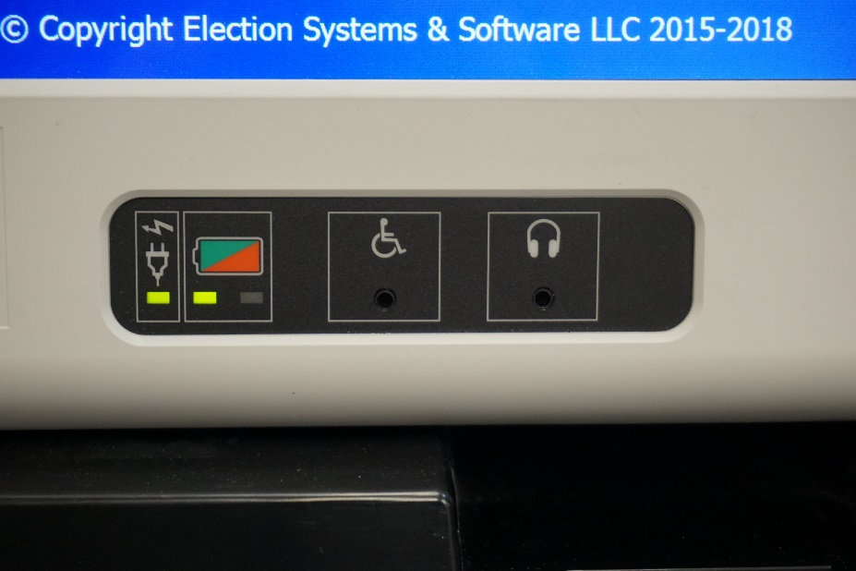
Accessibility Features
Keypad with Braille
Headphones
Notes:
The headphones should be plugged into the jack located on the front lower right hand corner of the machine.

Slide 30
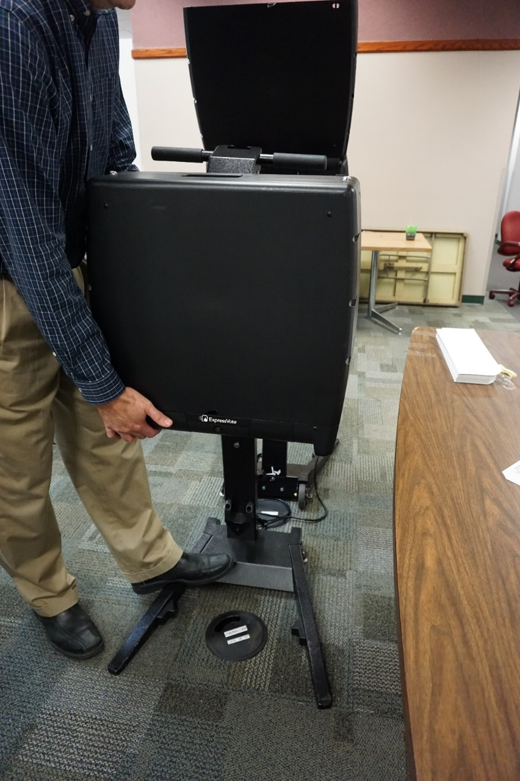
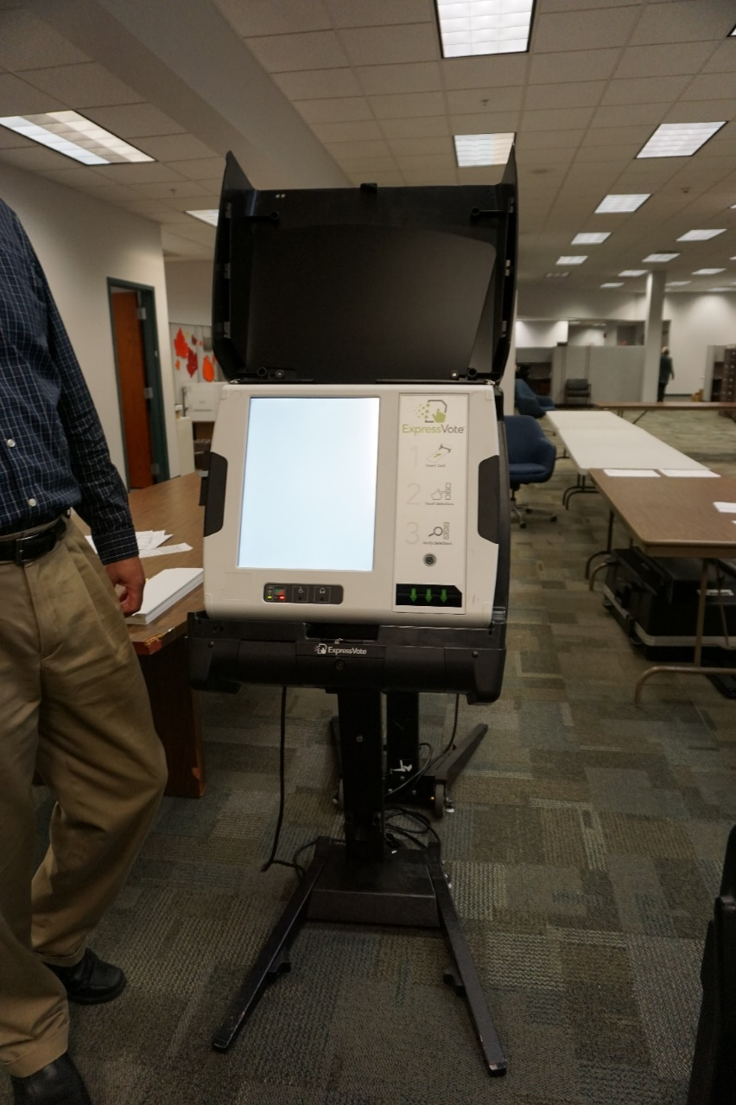
Plug in and open up machine
Slide machine into place or place on appropriate table and open up machine cover. If necessary, pull out privacy covers.

Slide 31
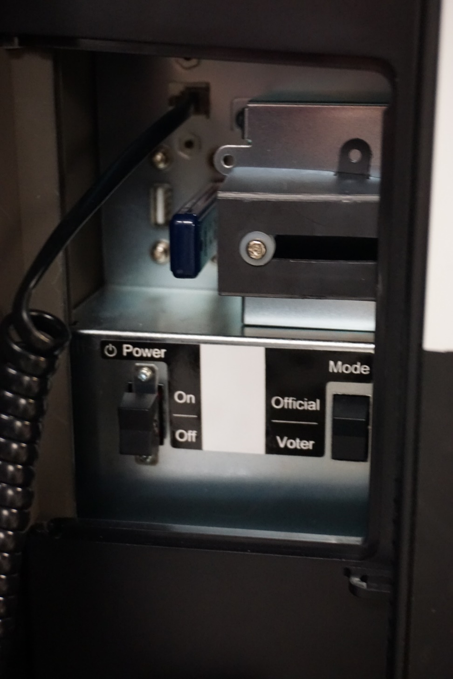
Unlock power compartment
Turn machine on
Verify memory stick is in the machine
Make sure the machine is in “voter” mode
Lock compartment up securely

Slide 32
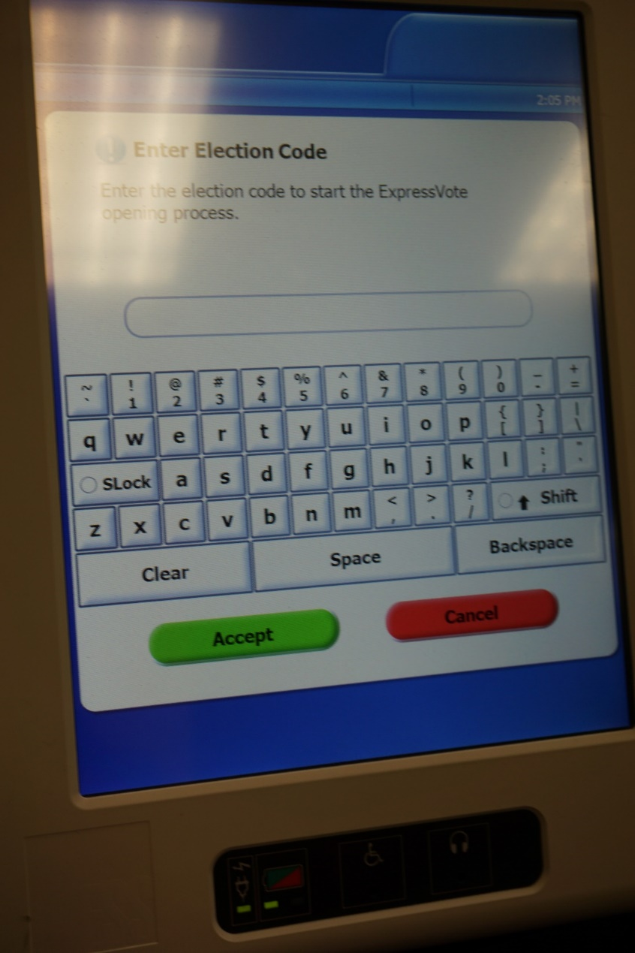
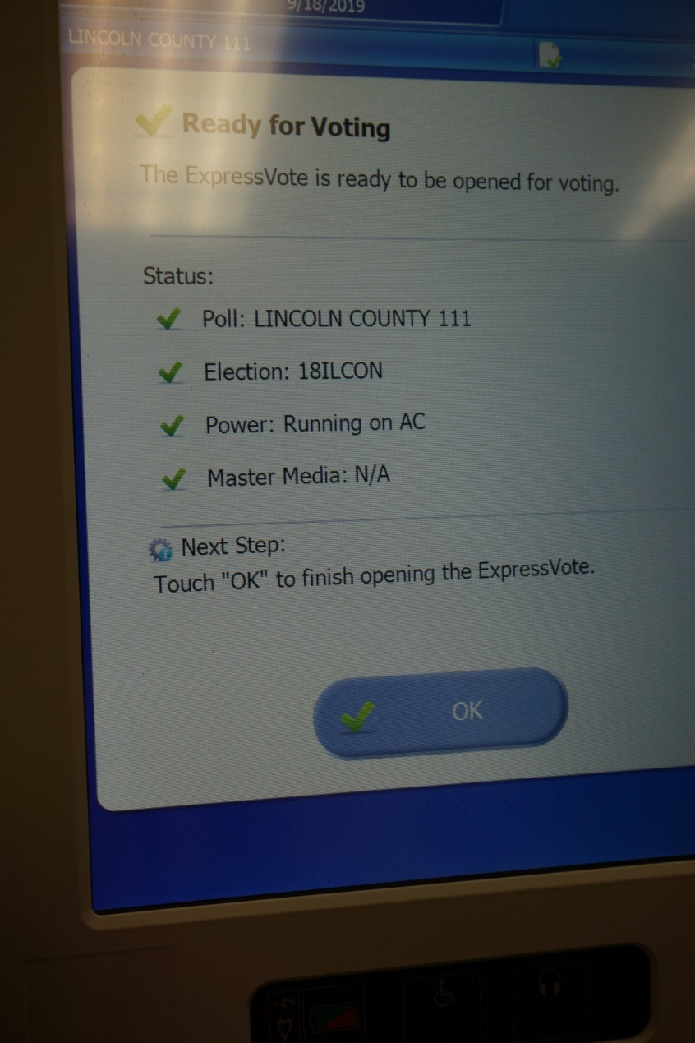
Press “ok” after the machine is finished setting up
Enter election code

Slide 33
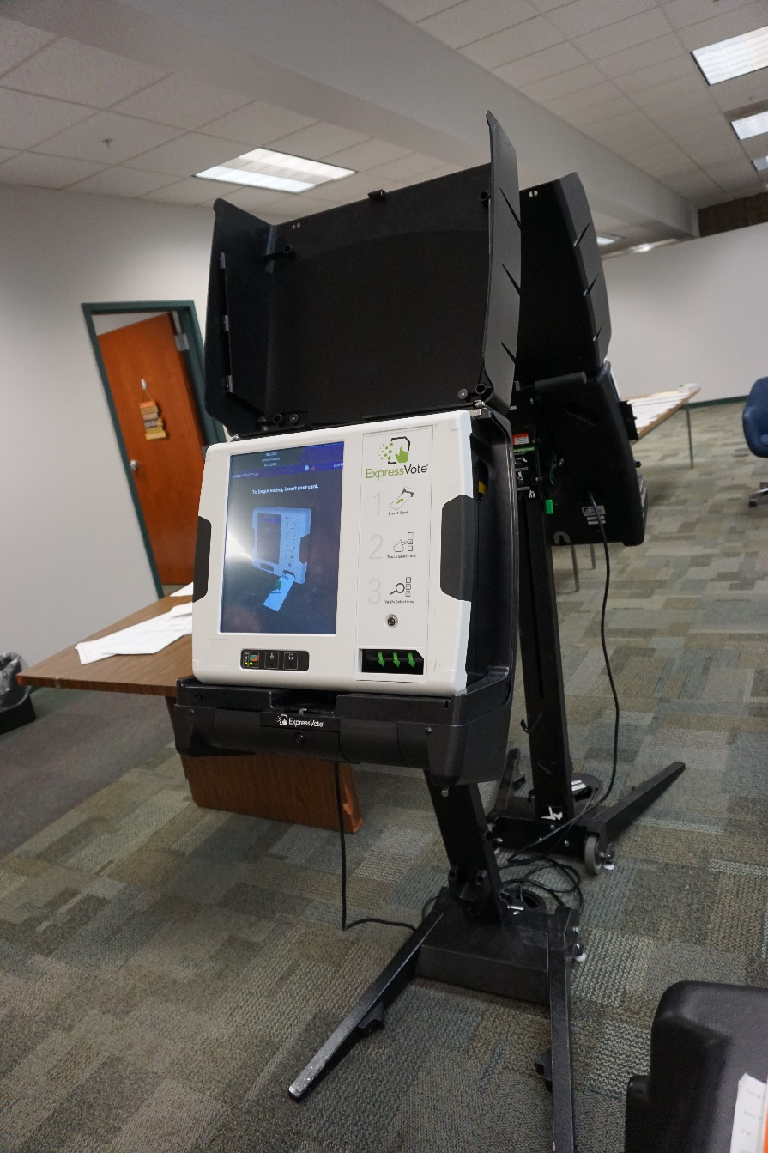
The Express Vote is Ready!

Slide 34
Pollwatcher Qualifications
Registered voter in Illinois
Must have credentials issued by the State Board of Elections or election authority
Are appointed by: Candidates, political parties, qualified civic organizations, state civic organizations, or are proponents and opponents to a proposition
Must have separate credentials for each precinct they enter, even if there are two precincts in one polling place!
Candidates CAN be pollwatchers

Slide 35
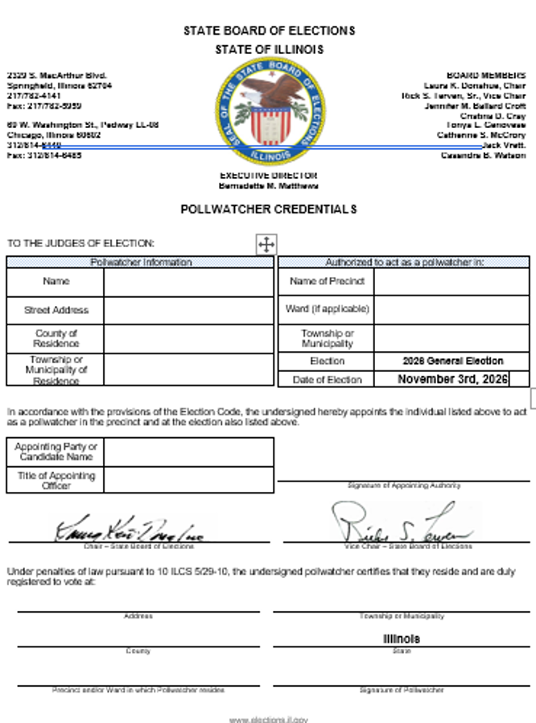
Pollwatcher Credentials
Collect when first enter polling place – YOU keep
Use sign in/sign out sheet when coming and going
Return credentials to election authority

Slide 36
Pollwatcher Rights
May observe all proceedings and records relating to the conduct of the election, but cannot touch or handle any of the material.
May come and go throughout the day as long as their behavior is not disruptive.
May call attention to incorrect procedure.
May challenge the qualifications of a voter.
Reminder: The secrecy of the ballot must be maintained.

Slide 37
Campaign Free Zone
100 horizontal feet from the ENTRANCE to the polling place/room
No campaign buttons
No electioneering
No campaign signs
You are the sole authority of the
Campaign Free Zone!
Notes:
Any person who violates this section may be punished for contempt of court.
Electioneering is defined as working for, or in the interest of a candidate, party or proposition.

Slide 38
During Voting Hours:
Chapter 2

Slide 39
At 6:00 A.M…
Announce out loud “Polls are Open!”
Unlock the door
Replace missing judges if approved by EA
Collect any pollwatcher credentials

Slide 40
A list will be provided for Early, Vote by Mail, and Grace Period Voters.
A voter cannot revoke or cancel a ballot that has already been voted!
If a voter is marked as already voted and claims they have not, call the election authority’s office!
If a voter was issued a Vote by Mail ballot, has not voted it, and surrenders the ballot to you on election day, he/she may vote as normal.
If a voter claims he/she never received their Vote by Mail ballot, he/she may sign an affidavit and vote on election day.

Slide 41
Voters may be challenged by Pollwatchers, Election Judges, or another voter.
Reasons for the challenge:
Voter has moved
Voter has already voted
Voter has changed name
No record of registration
Not the same person as registered voter

Slide 42
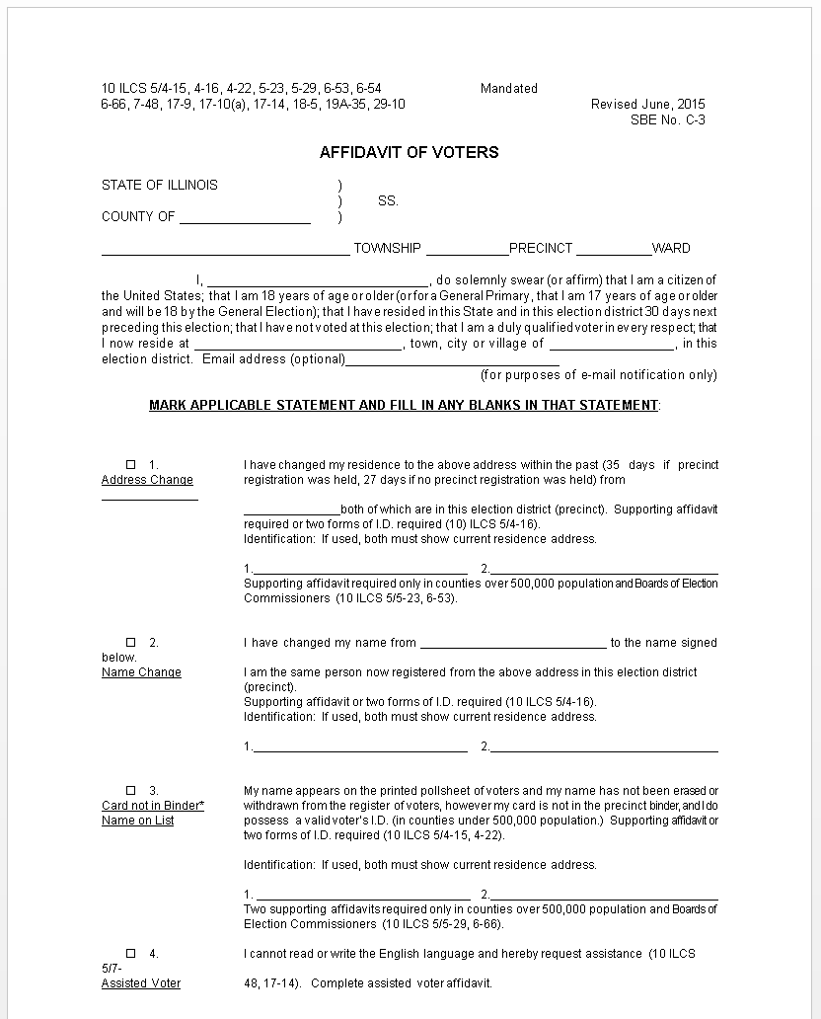
Voter Affidavit
Change of Residence
Name change (same precinct)
Name on list, no digitized signature to compare
Vote by Mail ballot not received
911 Address change

Slide 43
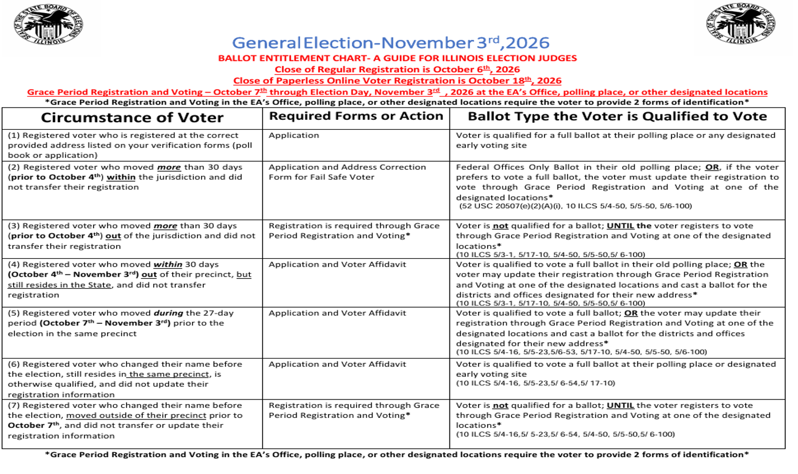
Ballot Entitlement Chart
Notes:
This chart will be with your precinct kits.
Leave this chart out on your table on Election Day to help with different situations that may occur, and how to handle those situations.

Slide 44
What if…
Voter’s registration cannot be found
Voter is challenged by a pollwatcher
Voter insists he or she is eligible to vote
Voter applied for registration at drivers license facility or on-line
Contact your election authority’s office for additional information and instruction!
Notes:
The election authority has the information the entire jurisdiction, you only have it for you precinct.
Don’t know how to answer a question? Confused? Call the EA!

Slide 45
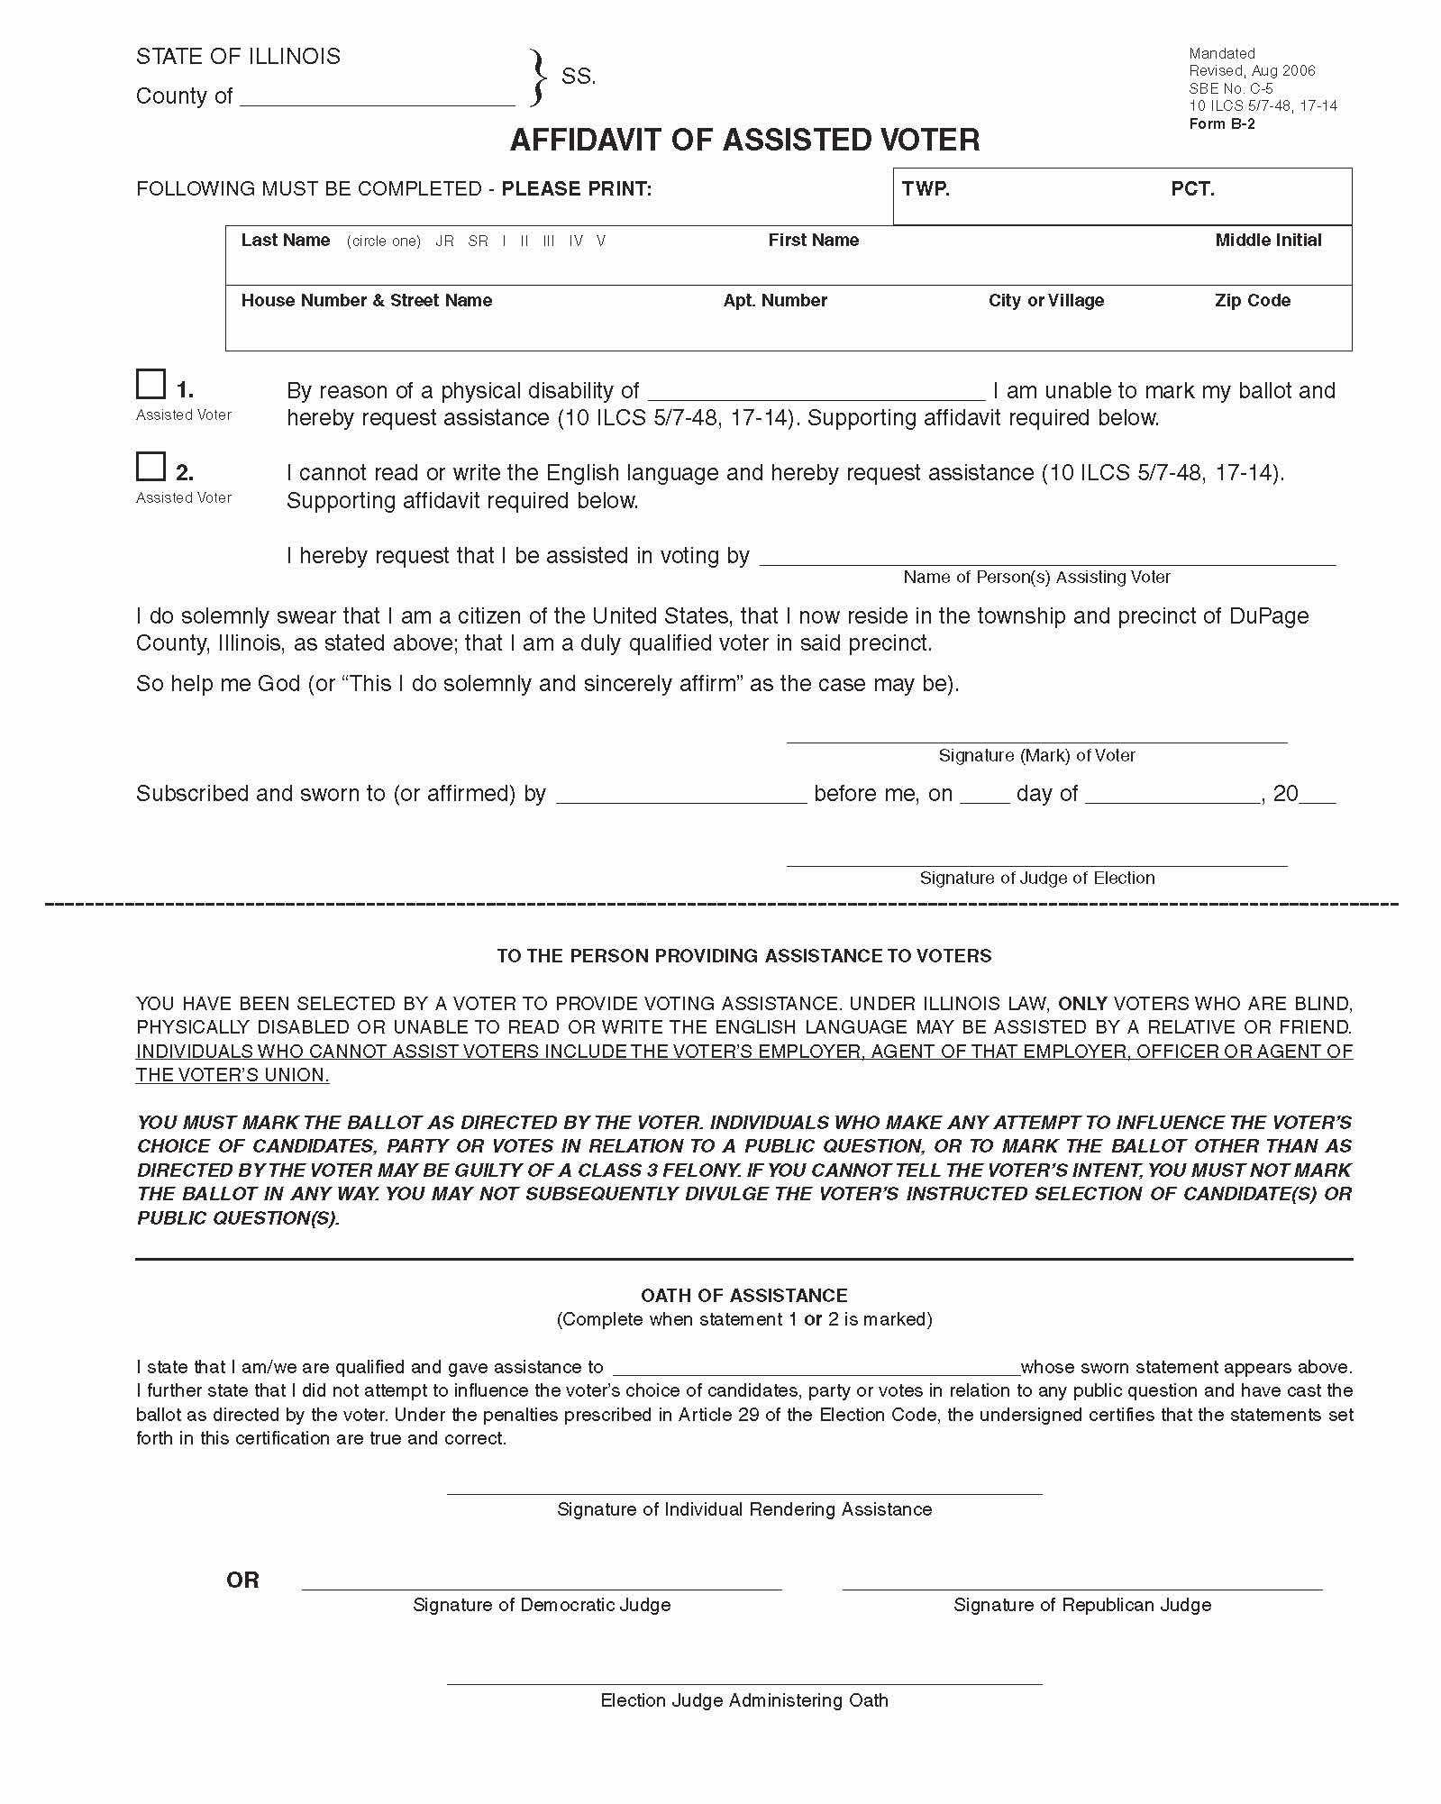
Voter Assistance: for Voters with Disabilities or Voters who can’t Read or Write the English Language.
Affidavit of Assisted Voter must be filled out every time a voter receives assistance in the voting booth!
This affidavit must be spindled along with the voters application.

Slide 46
Who can and can’t give assistance?
Who can give Assistance?
Who can’t give assistance?
Friend
Relative
Two Election Judges (one from each political party)
Voter’s employer
Agent of the voter’s employer
Officer of the voter’s union
Agent of the voter’s union
Remember: Fill out Affidavit!

Slide 47
Judge’s Station #1 – Application Judge
Voter states his or her name and address – verify it matches your records
Verify voter has not already voted – check your list!
Complete application
Notes:
Station One: The applications to vote, the affidavits, demonstrator ballot sheets, and a number of pens should be placed at this station.

Slide 48
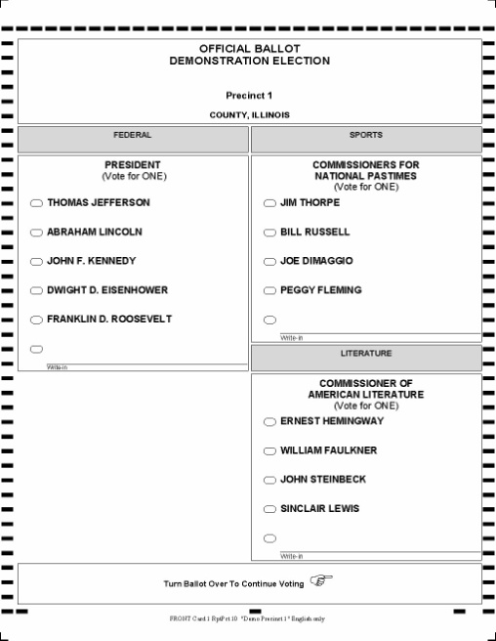
(cont.) Judge’s Station #1 – Application Judge
Offer voter instructions on Demonstrator Ballot Sheet and remind voter to turn the ballot over to vote for issues on the back (if applicable).
Announce voter’s name and address out loud.
Pass the application to the verification judges at station #2.

Slide 49
Judge’s Station #2 – Verification Judges
Two Judges of Opposite Parties
Locate voter’s verification record
Compare/verify signature and address on the application matches the voter’s record
Determine the correct ballot style
Initial the application
Notes:
Station Two: The scanned signatures, binder books, electronic pollbooks, and a listing of the different ballot styles should be placed at this station.

Slide 50
Judge’s Station #3 – Ballot Distribution
Check application for judge’s initials and ballot style
Spindle applications and number consecutively
Determine/locate correct ballot sheet
Notes:
Station Three: The spindles for the applications and the ballots should be placed at this station.

Slide 51
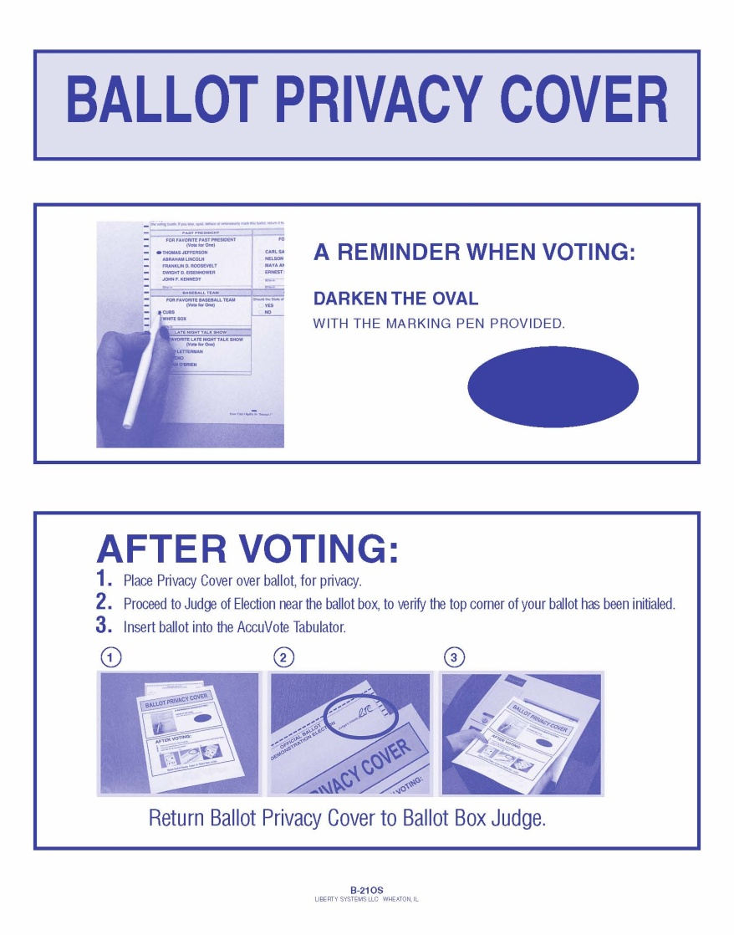
(cont.) Judge’s Station #3 – Ballot Distribution
Initial ballot sheet in RED ink
Provide voter with correct ballot style
OFFER secrecy sleeve and instruction reminders on voting and use of sleeve
Direct voter to voting booth
Notes:
If there are two different precincts in one polling place, you can use two different colors to initial ballot sheets for easier separation.

Slide 52
Spoiled Ballots
Voter should request a new ballot
Judge will mark the voter’s application
Ballot envelopes will be placed in the “Before 7:00 P.M.” envelope for spoiled ballots
Voter will process and tabulate the corrected ballot as normal

Slide 53
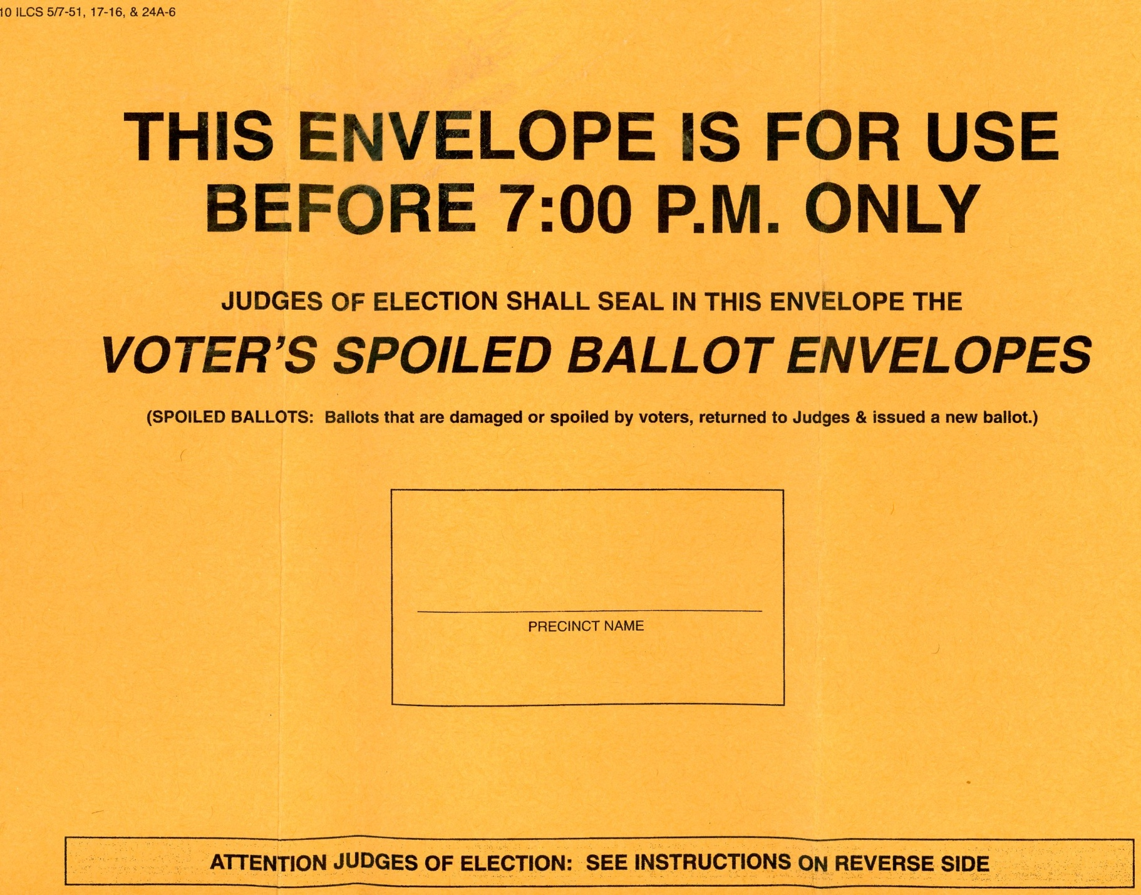
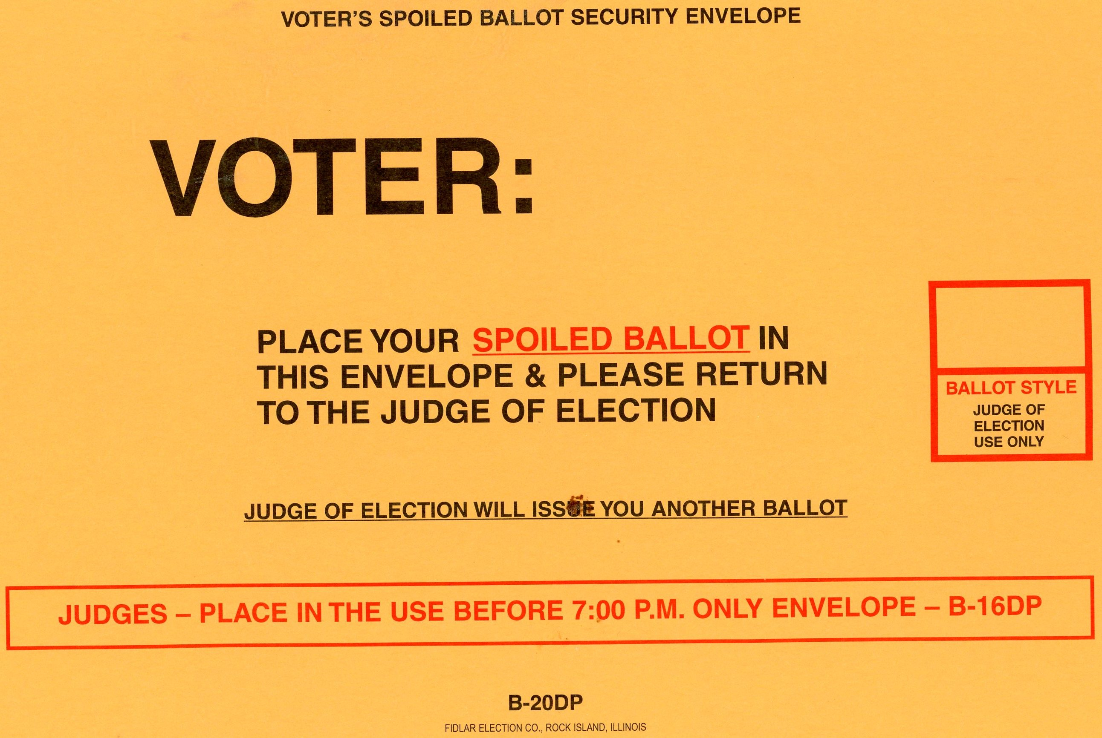
Voter places ballot in this envelope and seals envelope.
Election judge puts voter envelope into above envelope.

Slide 54
Place all spoiled ballots in this envelope together.

Slide 55
Provisional Voting? Call your election authority!
Why do we have provisional voting?
Reduces confrontation
Corrects mistakes in the registration process
Updates voter records
Judge’s have no record of registration and they refuse to register
Voter did not provide ID when registering by mail and cannot provide it on election day
Voter’s voting status has been challenged
Voter’s name appears on list of people voting early
When should you use provisional voting?
Notes:
If it was determined at the first station that the voter is only eligible for a provisional ballot, contact the election authority to determine the provisional voter’s correct precinct, then follow the procedures.
The voter now has seven calendar days after the election to follow up with the election authority to prove that they were eligible to vote.
The election authority then has up until 14 days after the election to decide if these provisional ballots are to be processed or not.

Slide 56
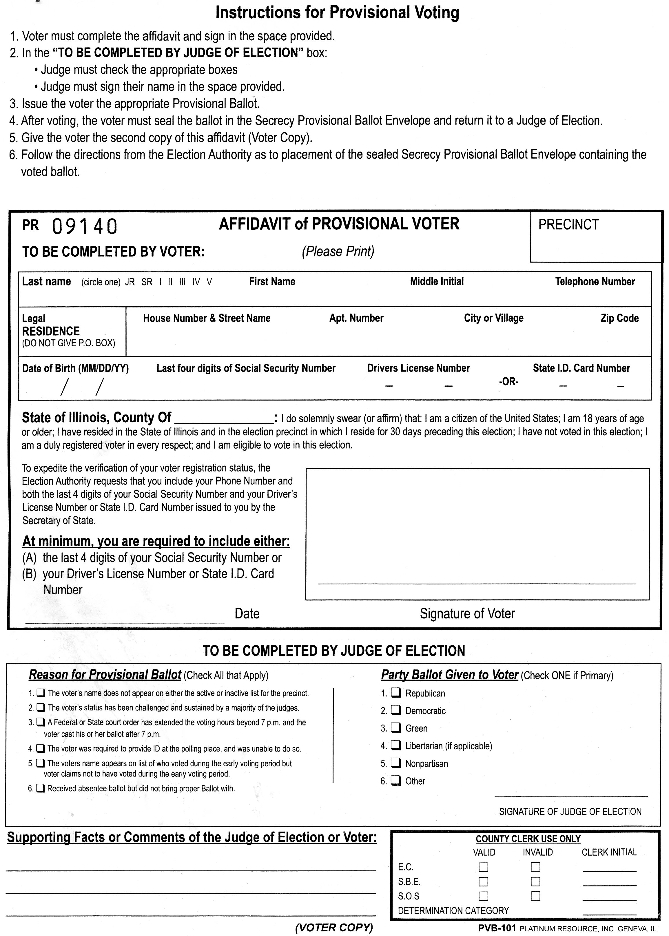
Provisional Voter Affidavit
Voter and election judge both have sections to fill out on the affidavit.
Election judge keeps this sheet while the voter votes the ballot.
There is a yellow carbon copy behind this sheet for the voter after they vote.

Slide 57
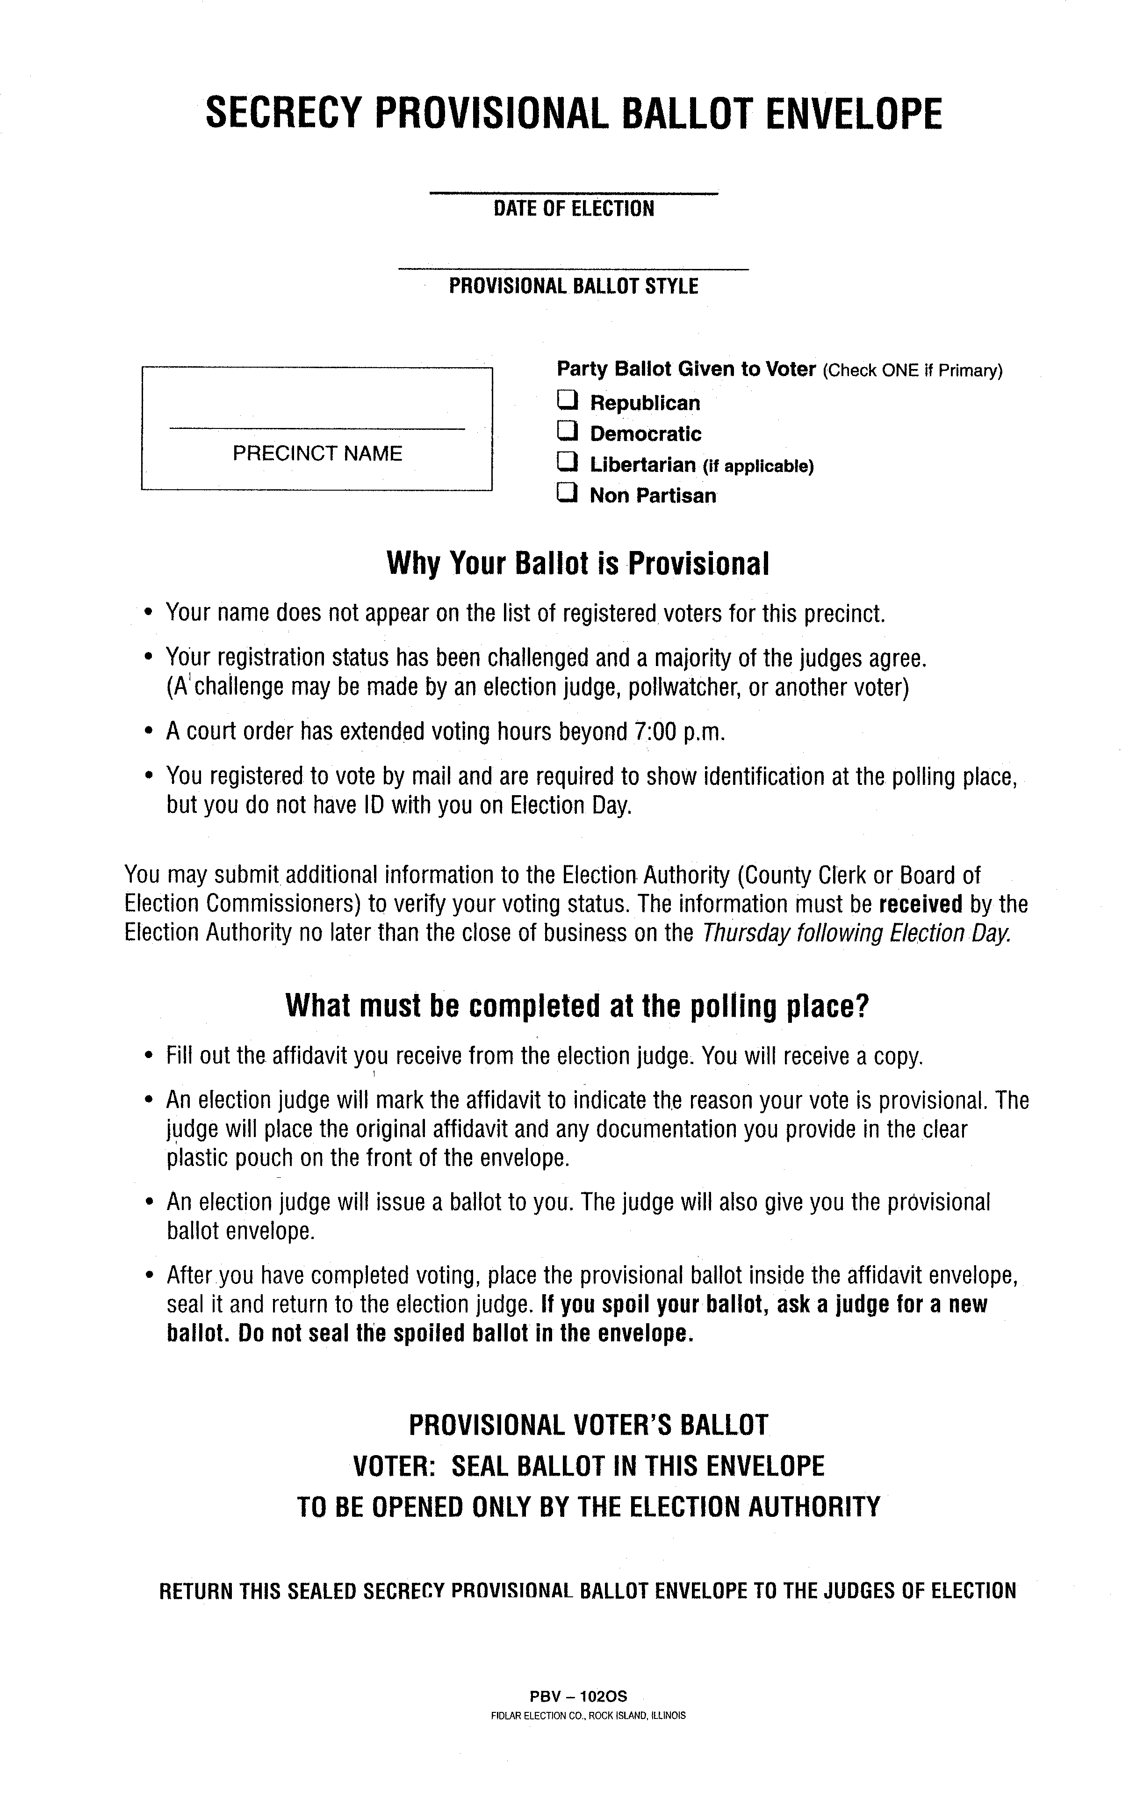
Secrecy Envelope
Voter takes this into the voting booth with them.
Voter inserts their completed ballot into this envelope and seals it before leaving the booth.

Slide 58
Provisional Ballots
DO NOT
Go into the Tabulator!

Slide 59
Verify the number of applications = the number of ballots cast!
Track
Your
Numbers!
Check your numbers every hour. If you are “in balance” every hour, you will be “in balance” when the polls close!

Slide 60
Judge’s Station #4 – Ballot Box Judge
Checks ballot for judge’s initials
Voter inserts ballot into the tabulator
Check voting booths
Notes:
Station Four: Extra secrecy sleeve covers should be kept at this station.

Slide 61
Over/Under Voted Ballot
The machine will identify the ballot.
Voter can either spoil that ballot and request a new one, cast the ballot “as-is”, or return to the voting booth and add votes to the SAME ballot.

Slide 62
Auxiliary/Emergency Bin
Use emergency bin for ballots
AFTER polls close, insert these ballots into tabulator
Voting should never stop!
Notes:
If the power goes out or there is an issue with the tabulator, contact the election authority immediately so they can send out the proper help.

Slide 63
Notify election authority the day before
Two election judges (one from each party)
Complete the process as if voter was in polling place:
  Voter completes application
  Judges do the verification
  Two judges deliver the ballot out with secrecy sleeve
  Voter will vote in secrecy
  Two judges will bring the ballot back inside and insert it into tabulator
Curbside Voting
Notes:
Cannot take place more than 50 feet from the polling place.

Slide 64
At 6:30 PM…
Announce the polls will close in one-half hour.
Don’t forget to vote if you are in your voting precinct!

Slide 65
At 7:00 PM…
Announce out loud “Polls are Closed!”
All voters in line at 7:00 PM are allowed to vote
Close and lock door
Remove polling place signs
Notes:
Try to get everyone in line at 7:00 PM into the polling place building. If this is not possible, put an Election Judge or Law Enforcement Official at the end of the 7:00 PM line so you as judges know where that line ends.

Slide 66
After the Polls Close:
Chapter 3

Slide 67
Who is Authorized to Remain in the Polls?
Election Judges
Pollwatchers
Law Enforcement Officials
Representatives of:
  State Board of Elections
  Attorney General
  State’s Attorney
  election authority

Slide 68
Open the Ballot Box
Remove ballots from the tabulator
Compare number of ballots to number of applications
Process write-in votes
Notes:
The number of ballots of each type must be the same as the number of applications for each ballot style.
If the numbers do not agree, recount the ballots and check that the applications are numbered/spindled correctly

Slide 69
Check Auxiliary/Emergency Bin
Before closing out the machine:
Remove ballots from emergency bin
Insert ballots into tabulator

Slide 70
DS200 Tabulator Shutdown

Slide 71
DS200 Tabulator Shutdown
Instructions will be provided

Slide 72

Press the “Close Polls” button next to the locked compartment by the screen.
Hit “Close Polls” on the screen.

Slide 73
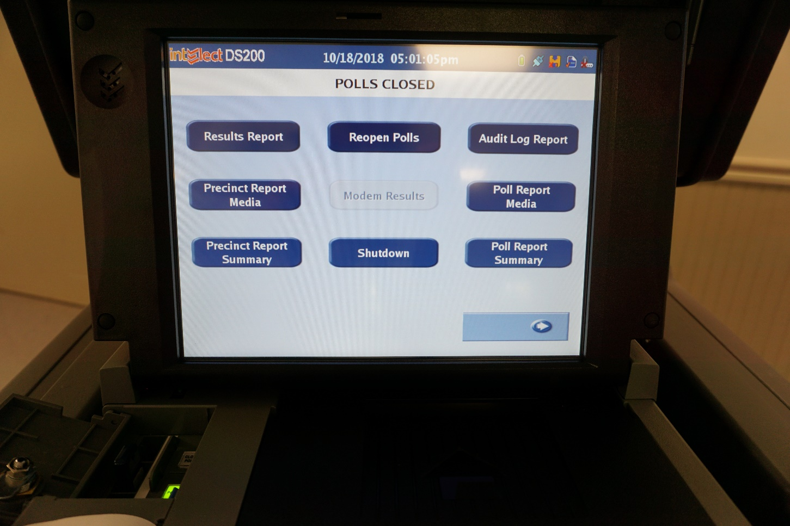
Press “Results Report”
Print as many copies as requested
Print copies for pollwatchers if requested
Notes:
Note: the judges may not have to press “results report” to print tapes for their county IF the election authority has already set up the machine to print the required number of tape copies.

Slide 74
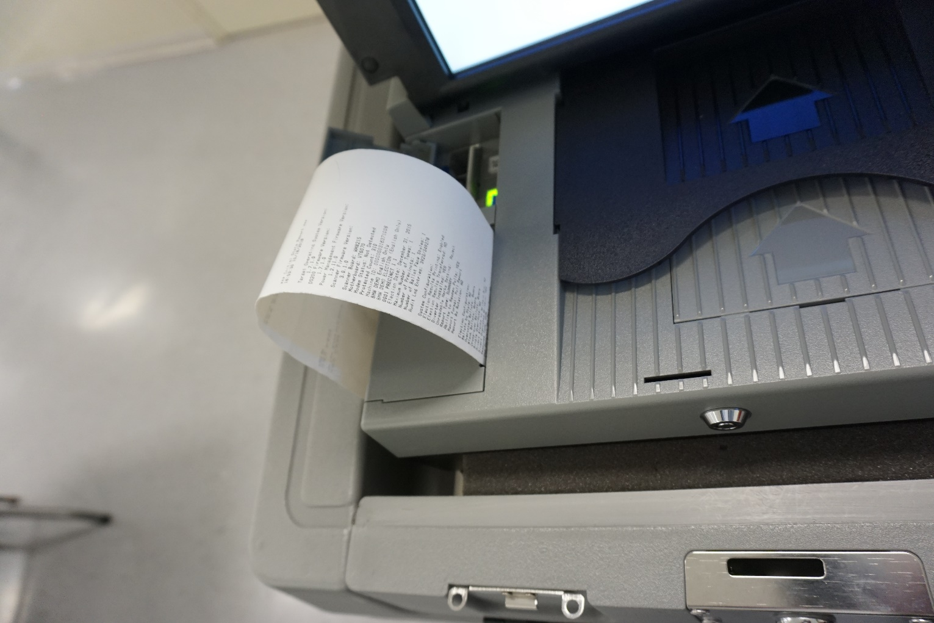
All judges must sign each tape!

Slide 75
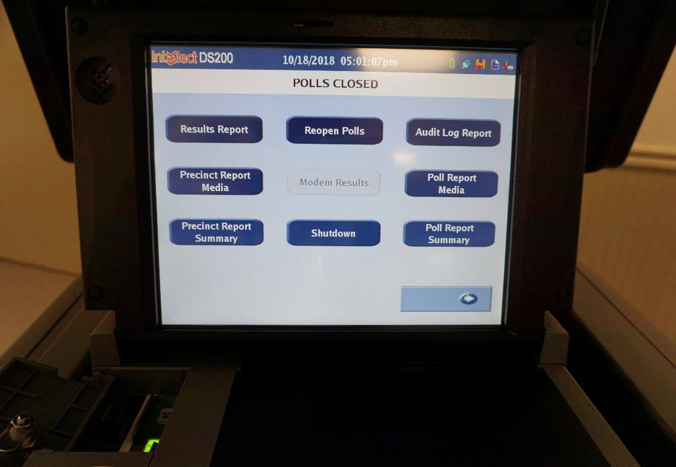
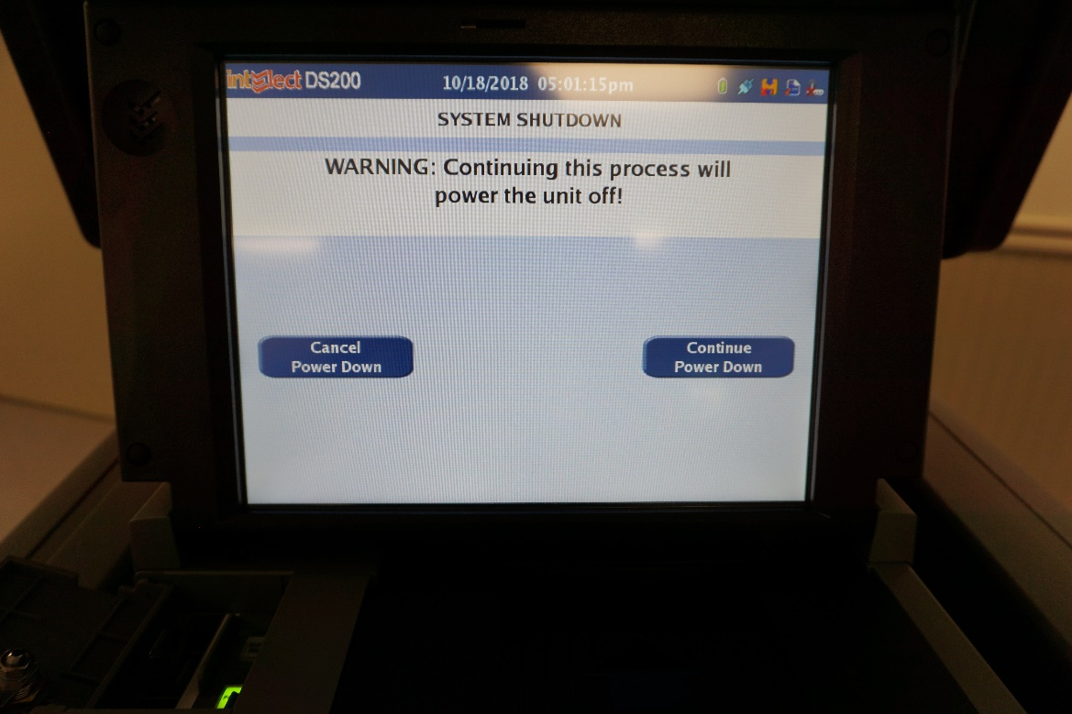
Press the “Shutdown” button and “Continue”

Slide 76
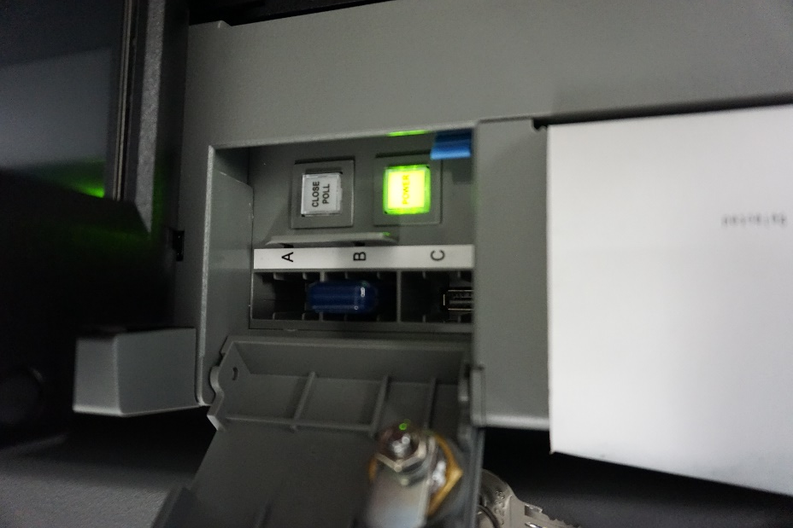
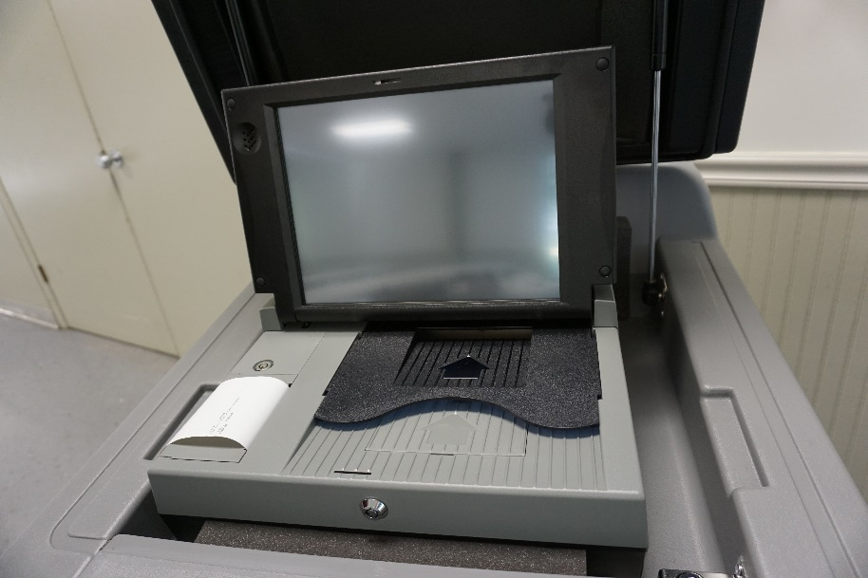
Follow your Election Authority’s instructions!
Remove memory stick and return to counting center.
Unlock entire tabulator and return to counting center.
Notes:
Update according to what the jurisdiction does.
-Remove memory card and return only the memory card to the counting center.
-Leave memory card in tabulator and return the entire tabulator to the counting center.
-Remove memory card, put in separate container, and return memory card AND tabulator to the counting center.

Slide 77
Express Vote Shutdown

Slide 78
Unlock power compartment
Turn machine off

Slide 79
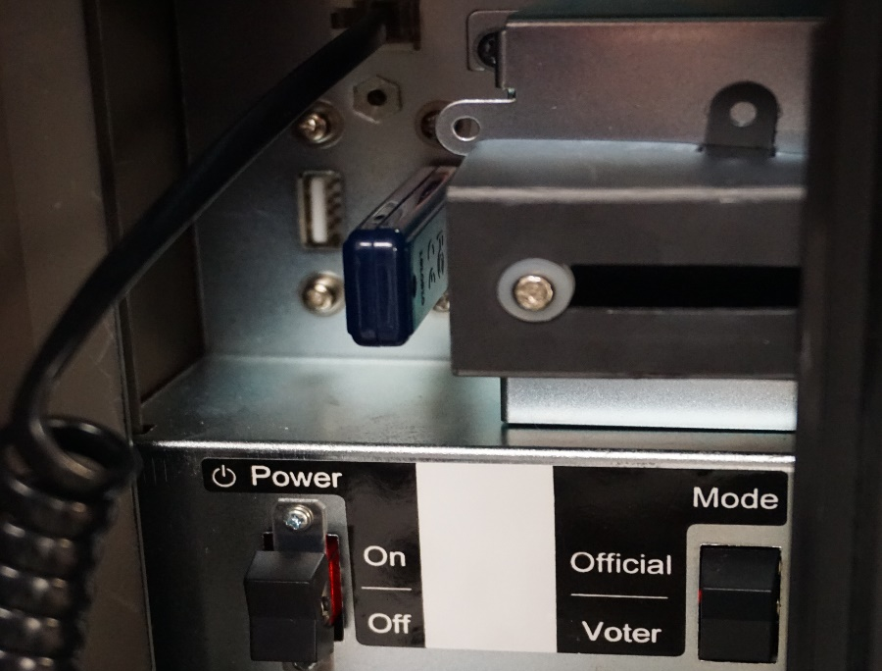
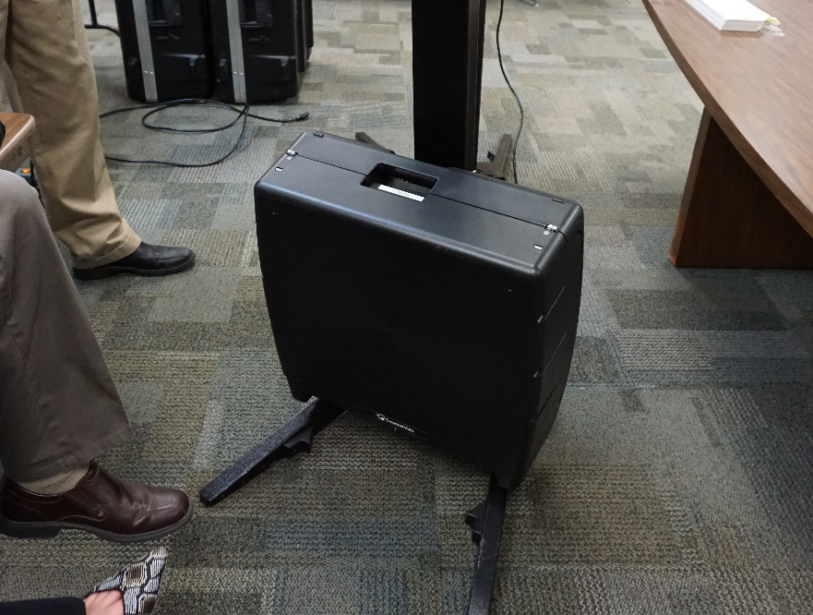
Follow your Election Authority’s instructions!
Remove memory stick and return to counting center.
Lock up entire machine and return to counting center.
Notes:
Update according to what the jurisdiction does.
-Remove memory card and return only the memory card to the counting center.
-Leave memory card in tabulator and return the entire tabulator to the counting center.
-Remove memory card, put in separate container, and return memory card AND tabulator to the counting center.

Slide 80
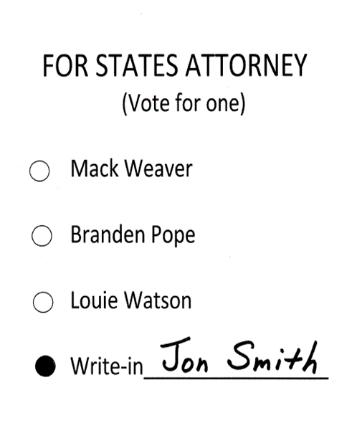
Processing Valid Write-In Votes
Must be on valid write-in sheet!
Determine the voter’s intent
Must be printed or written on ballot line
  No stamps
  No stickers
Oval must be darkened
Notes:
The spelling of a candidates name does not have to be exact as long as you can tell the voter’s intent.

Slide 81
Review checklist provided by your election authority and return proper materials
Tabulator Memory Card/Ballot Sheets/Tape
Touch Screen Memory Card/Canister/Tape
Envelope with Write-In Tally Sheets
Spindled Applications to Vote
Statement of Ballots
Signature Roster or Pollbooks
Voted Provisional Ballots
Completed Expense Sheets
Follow your election authority’s Instructions on Materials to Return!
Notes:
Update according to what the jurisdiction has requested to be added or taken away.

Slide 82
Complete and sign all forms
Leave your polling place clean and tidy

Slide 83
Returning Materials
Two eligible judges, one from each political party, will deliver the materials DIRECTLY to the election authority’s office when everything is done so the EA can close out the election.
Notes:
(PA 96-1003 states that after the polls close on Election Day, only the judges eligible to vote in that jurisdiction may return election results and supplies to the counting center. This law specifically does not allow return of supplies by high school students or college students serving as election judges…if they are not eligible to vote in that jurisdiction.)

Slide 84

Your election authority certifies the official election results!
Missing Vote by Mail ballots
Missing Early Vote counts
Missing possible Provisional Ballot counts
Notes:
Could take up to 21 days!

